Slide 1
DISCLAIMERS
This training guide has been prepared by the National Justice Project as part of their CopWatch project.
The material is subject to copyright under the Copyright Act 1968 (Cth), and it is owned by the National Justice Project. However, we encourage anyone to copy, distribute, display, download and otherwise freely deal with the material for any legitimate purpose.
This information is provided for information purposes only. The National Justice Project stands by its research into the laws in each Australian state and territory. However, laws do change over time. We will do our best to keep track of any changes. Therefore, while the information contained in the CopWatch website, app and training program has been formulated with all due care, the National Justice Project does not accept any liability to any person for the information (or the use of such information) which is provided.
Notes:
[PLEASE READ AND THEN DELETE THIS SLIDE BEFORE PRESENTING]

Slide 2
INSTRUCTIONS
Before presenting, please familiarise yourself with the contents of this PowerPoint presentation, the Trainer Guide and the Fact Sheet/s relevant to your location, as well as the CopWatch mobile application and website.
This presentation can be customised for individual communities depending on your location, the relevant needs of your community, how much time you have for training and the resources available to you.
Before presenting you will need to:
Remove any state/territory specific slides/content not relevant to your location or the training needs/interests of your community/participant group.
Edit or add any information relevant to your location, community and/or training needs.
Notes:
[PLEASE READ AND THEN DELETE THIS SLIDE BEFORE PRESENTING]

Slide 3
COPWATCH
COMMUNITY TRAINING
Notes:
Important Note: All legal information contained in the CopWatch training materials, mobile application and website are current as of March 2023. Before delivering training, we strongly recommend checking for updates to the rules around filming and dealing with police in your state/territory.
DISCLAIMERS
This training guide has been prepared by the National Justice Project as part of their CopWatch project.
The material is subject to copyright under the Copyright Act 1968 (Cth), and it is owned by the National Justice Project. However, we encourage anyone to copy, distribute, display, download and otherwise freely deal with the material for any legitimate purpose.
This information is provided for information purposes only. The National Justice Project stands by its research into the laws in each Australian state and territory. However, laws do change over time. We will do our best to keep track of any changes. Therefore, while the information contained in the CopWatch website, app and training program has been formulated with all due care, the National Justice Project does not accept any liability to any person for the information (or the use of such information) which is provided.
INSTRUCTIONS
Before presenting, please familiarise yourself with the contents of this PowerPoint presentation, the Trainer Guide and the Fact Sheet/s relevant to your location, as well as the CopWatch mobile application and website.
This presentation can be customised for individual communities depending on your location, the relevant needs of your community, how much time you have for training and the resources available to you.
Before presenting you will need to:
Remove any state/territory specific slides/content not relevant to your location or the training needs/interests of your community/participant group.
Edit or add any information relevant to your location, community and/or training needs.

Slide 4
We acknowledge that we live and work on the lands of First Nations peoples, and we pay our respects to their Elders, past and present. The National Justice Project Sydney office is located on the lands of the Gadigal people of the Eora Nation, whose sovereignty was never ceded. This land is, and always will be, Aboriginal land.
COPWATCH
4
Notes:
[EDIT THE ACKNOWLEDGEMENT AS NEEDED SO THAT IT IS SPECIFIC TO YOUR LOCATION/COMMUNITY]
ACKNOWLEDGEMENT OF COUNTRY
We acknowledge that we live and work on the lands of First Nations peoples, and we pay our respects to their Elders, past and present. The National Justice Project Sydney office is located on the lands of the Gadigal people of the Eora Nation, whose sovereignty was never ceded. This land is, and always will be, Aboriginal land.

Slide 5
CONTENT
WARNING
Aboriginal and Torres Strait Islander people are advised that the CopWatch training materials and website may contain images, voices and names of people who have passed away.
Some of the content may be confronting and distressing. Take care and if you need support contact:
13YARN on 13 92 76
Brother to Brother on 1800 435 799
Lifeline on 13 11 14
COPWATCH
5
Notes:
[EDIT THE WARNING & CONTACTS AS NEEDED ACCORDING TO YOUR TRAINING AGENDA & COMMUNITY/GROUP]
CONTENT WARNING
Aboriginal and Torres Strait Islander people are advised that the CopWatch training materials and website may contain images, voices and names of people who have passed away.
Some of the content in this training may be confronting and distressing. If you need to, take a break at any point. If you need additional support during the session, please let me know.
Please take care and if you need support you can contact:
13YARN: call 13 92 76 or visit https://www.13yarn.org.au/ – 24/7 crisis support for First Nations people
Brother to Brother: call 1800 435 799 or visit https://www.dardimunwurro.com.au/brother-to-brother/ – 24/7 crisis line for First Nations men
Lifeline: call 13 11 14 or visit https://www.lifeline.org.au/
Kids Helpline: call 1800 55 1800 or visit https://kidshelpline.com.au/
More services are available at the end of these slides and on the CopWatch website at: https://www.copwatch.org.au/legal-help

Slide 6
TRAINING
AGENDA
Housekeeping & Introductions
About CopWatch
Using the CopWatch App
Filming Police
Dealing with Police
Police Misconduct & Making a Complaint
Q&A
COPWATCH
6
Notes:
[EDIT THIS SLIDE AS NEEDED ACCORDING TO YOUR TRAINING AGENDA]
TRAINING AGENDA
Housekeeping & Introductions
About CopWatch
Using the CopWatch App
Filming Police
Dealing with Police
Police Misconduct & Making a Complaint
Q&A

Slide 7
HOUSEKEEPING
Be kind and respectful – listen to each other
This is a safe space – anything you share will stay private/confidential
You can say as much or as little as you want
Don’t share anything that can incriminate you
Some of the content can be distressing – take breaks if you need to
COPWATCH
7
Notes:
[EDIT THIS SLIDE AS NEEDED ACCORDING TO YOUR TRAINING AGENDA, LOCATION & COMMUNITY/GROUP]
HOUSEKEEPING
Be kind and respectful – listen to each other and don’t interrupt when someone else is sharing
This is safe space – anything you share will remain private/confidential
When sharing you can say as much or as little as you feel comfortable
Don’t share anything that might incriminate you or someone else (eg there are mandatory reporting laws for some offences)
Some of the content in this training can be distressing – if you need to, take a break, grab a cup of tea, get some fresh air/sun, call a friend or pull me (or another training assistant) aside.
More information on mandatory reporting:
In the ACT, NT, Qld, SA, Tas & WA, legislation requires mandatory reporting in relation to all children/young people up to the age of 18 years (eg re child abuse/neglect)
In NSW, reporting is mandatory for children/young people up to the age of 16 years.

Slide 8
INTRODUCTIONS
Your name
Where you are from
What you want to get out of today (or why you are here)
Something you are looking forward to (or something you did on the weekend)
COPWATCH
8
Notes:
[EDIT THIS SLIDE AS NEEDED ACCORDING TO YOUR TRAINING AGENDA & YOUR COMMUNITY/GROUP]
ACTIVITY – INTRODUCTIONS
Going around the room, tell us a little bit about yourselves. I’ll start if you like?
Tips:
Trainers should answer the icebreaker question/s first to help break any awkward silences and open up the conversation.
ACTIVITY – PERCEPTIONS OF POLICE
Call out the first thing that comes to mind when thinking about interactions with police in your community.
Tips:
We recommend doing this activity twice – once at the start of the training, then again at the very end of the training – and comparing notes at the end to see if there are any differences in participant reactions and perspectives.
The goal of this activity is to get participants to call out the very first thing that comes to mind, without thinking too much about it.
Note participant responses on the chalk/whiteboard, butcher paper or a piece of paper/notebook. You can ask for a volunteer to help you.
If you are using a chalk/whiteboard, you may need to take a photo after the first round of responses in case you need to erase the board for later activities.
For larger groups, you can ask participants to write their answers down on a piece of paper and either go around the room or pin/stick them up on the board.
This activity can also be good way to gauge the experiences and vibe of the group at the start of the training in case you need to consider making any adjustments to the training.
This activity can also be used as an alternative ice-breaker for larger groups.

Slide 9
ABOUT COPWATCH
SECTION OVERVIEW
About CopWatch
Why CopWatch was created
Who can use CopWatch
COPWATCH
9
Notes:
[EDIT THIS SLIDE AS NEEDED ACCORDING TO YOUR TRAINING AGENDA]

Slide 10
ABOUT COPWATCH
CopWatch is a mobile application, website, and training package designed to help keep communities safe and hold police accountable
CopWatch was created by the National Justice Project – a proudly independent not-for-profit human rights legal and civil rights service dedicated to eradicating systemic discrimination
Website: copwatch.org.au
Contact: contact@copwatch.org.au
COPWATCH
10
Notes:
ABOUT COPWATCH
CopWatch is a mobile application, website and training package designed to help keep police accountable and keep communities safe.
CopWatch was developed by the National Justice Project - a proudly independent not-for-profit human rights legal and civil rights service dedicated to eradicating systemic discrimination (www.justice.org.au)
More information about the different components of CopWatch:
The CopWatch app:
allows you to send a text message alert to up to 3 pre-selected contacts together with a map showing your location if you are in trouble
allows you to video record incidents, and provides instructions to keep your videos safe
The CopWatch website:
contains information about individual rights and responsibilities when interacting with and recording police, including how to safely and legally record interactions with police
provides a list of organisations that offer support and legal advice
The CopWatch community training & education program:
is designed to live within community and allows CopWatch tools and knowledge to be used freely, as each community determines appropriate
prioritises maintaining and delivering CopWatch training that is locally relevant and community-owned. This is critical to the program being effective and the learnings and impacts lasting

Slide 11
WHY COPWATCH WAS CREATED
CopWatch was created to:
Empower local communities
Hold police accountable
Help people film police safely
Keep people and communities safe
Reduce negative interactions with police
Improve police-community relations and rebuild trust
Reduce incarceration rates and criminalisation
COPWATCH
11
Notes:
WHY COPWATCH WAS CREATED
CopWatch was created by the National Justice Project in 2017 to support First Nations communities respond to police over-reach and discrimination, which continues to have devastating impacts on families and communities.
CopWatch is intended to provide communities with tools, knowledge, and skills to improve engagement, trust and police accountability, and promote safer police-community interactions.
CopWatch was created to:
Empower local communities
Help people film police safely and legally to hold police accountable
Keep kids and communities safe
Reduce negative interactions with police
Improve police-community relations and rebuild trust
Reduce over-incarceration and criminalisation.

Slide 12
WHO CAN USE COPWATCH
Anyone can use CopWatch, including bystanders/witnesses and protestors
CopWatch is designed for communities who experience racism and discrimination by police, including:
Aboriginal and Torres Strait Islander people
LGBTQIA+ and culturally and linguistically diverse people
People with disabilities and mental health conditions
People experiencing homelessness, domestic violence, substance use/dependence
COPWATCH
12
Notes:
WHO CAN USE COPWATCH
Anyone can use CopWatch, including people experiencing police violence and misconduct, bystanders/witnesses, protestors
CopWatch is specifically designed for communities who face discriminatory police practices. These communities include:
Aboriginal and Torres Strait Islander people
Members of the LGBTQIA+ community
Culturally and linguistically diverse people
People experiencing domestic and family violence
People with disabilities
People experiencing mental ill-health
People experiencing homelessness
People experiencing substance use/dependence

Slide 13
USING COPWATCH
SECTION OVERVIEW
App Download & Set-Up
Using the app
Key Features
Sending Alerts
Managing Your Info and Videos
Protecting Your Videos
COPWATCH
13
Notes:
[EDIT THE SLIDES IN THIS SECTION AS NEEDED ACCORDING TO YOUR TRAINING AGENDA]
ACTIVITY:
If you choose, you can download and set-up the app at the same time while we run through each stage of the training for setting up and using the app:
App download
App set-up:
Name
Contacts
Permissions
Rights/Responsibilities
Using the app:
Sending alerts
Making a video
Managing your info and videos
Tips:
Make it interactive!
Participants can go through each of the steps for setting up and using the app with you on their phones.
Don’t forget to ask participants to download the app, either prior to or on arrival at training, depending on Wi-Fi access at the training site.
Allow time for questions and helping participants as needed.
Consider having a co-trainer or allocating a volunteer to help participants individually. You can also encourage participants to help each other.
Feel free to pass on any questions or feedback on the app via email to contact@copwatch.org.au.

Slide 14
APP DOWNLOAD & SET-UP
COPWATCH
14

Slide 15
APP DOWNLOAD
Search ‘copwatch’ in App Store or Google Play
Select ‘copwatchau’ and download the app for free
Open the app and follow the steps to set-up CopWatch on your phone
COPWATCH
15
Notes:
APP DOWNLOAD
Search ‘copwatch’ in App Store or Google Play.
Select ‘copwatchau’ and download the app for free.
Open the app and follow the steps to set up the app on your phone.

Slide 16
APP SET-UP
Set-up as soon as possible so your app is ready to use
CopWatch works best when you accept all permissions – you can update permissions at any time in app settings
CopWatch does not access or use any personal info or data on your phone
COPWATCH
16
Notes:
APP SET-UP
Set-up the CopWatch app as soon as possible, so your app is ready to use if you are involved in an incident with police. Set-up is quick and simple and takes just a few minutes!
The CopWatch app works best when you accept all permissions (but this is not mandatory/required to use the app).
You can update your permissions at any time by going to the CopWatch app settings on your phone.
The CopWatch app does not collect, have access to or use any data on your phone.
If you have any concerns, see the CopWatch app Privacy Policy for more information: www.copwatch.org.au/privacy

Slide 17
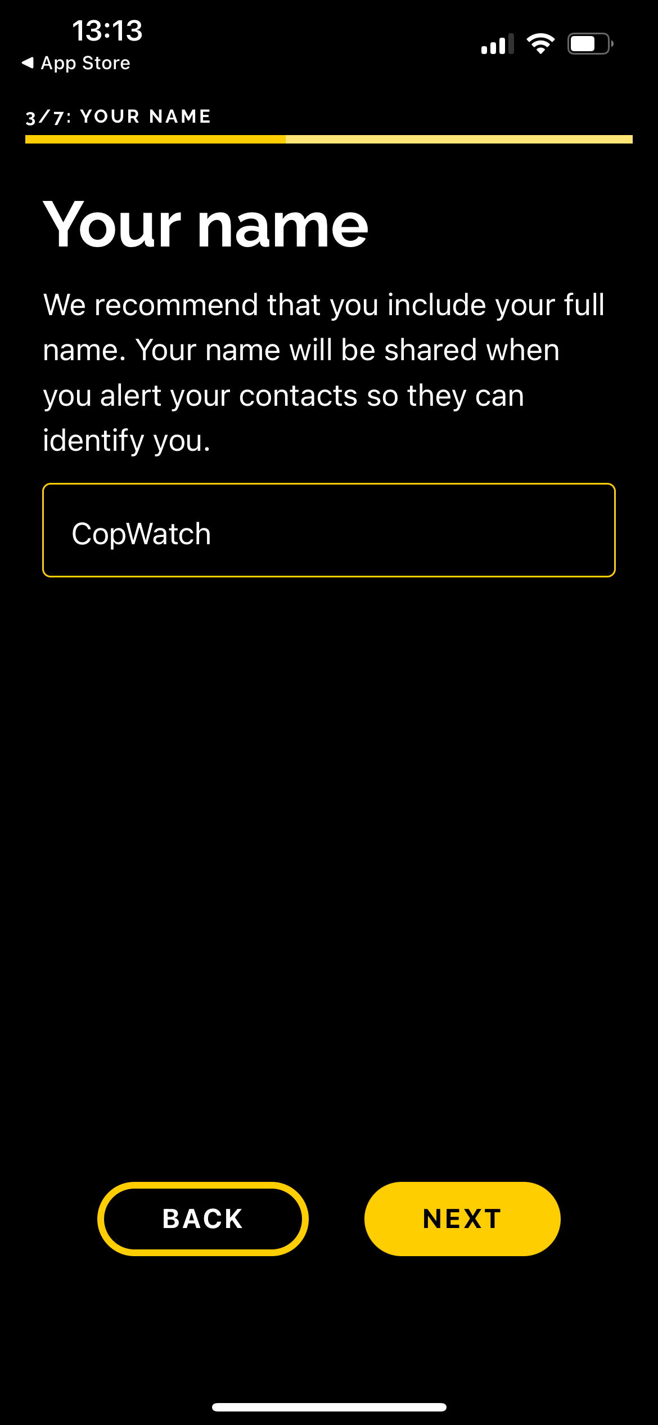
STEP 1 – YOUR NAME
Enter your name (optional)
The name you enter will be used in alerts sent to your chosen contacts
You can update your name any time in app settings
COPWATCH
17
Notes:
STEP 1 – YOUR NAME
Add your name in the text box.
We recommend that you include your full name. Your name will be shared when you alert your contacts so they can identify you.
Adding your name is optional. To skip this step, select ‘next’.
You can update your name in the CopWatch app at any time by going to Settings > Edit > Edit my name.

Slide 18
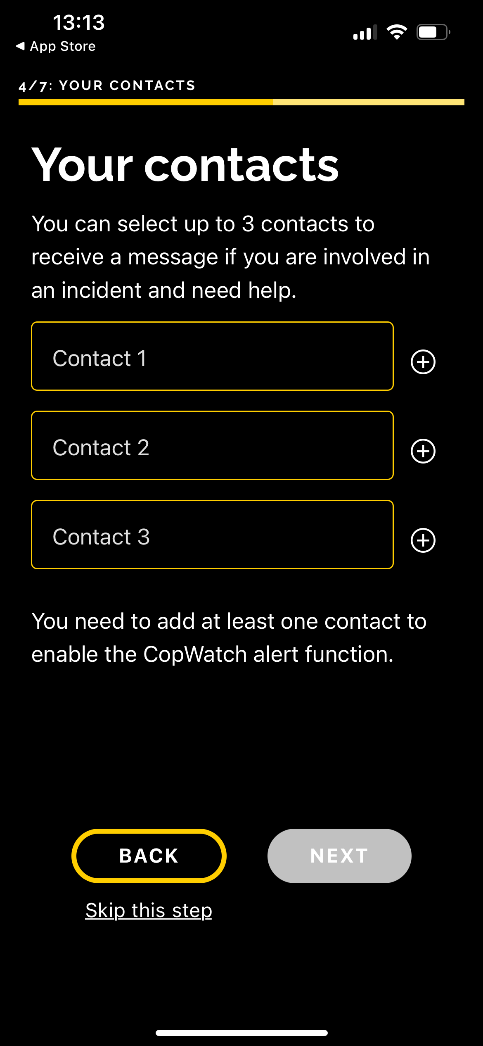
STEP 2 – YOUR
CONTACTS
Follow the steps to select up to 3 contacts (optional, requires permissions)
Choose people you trust and can help (eg mates, family, trusted adults)
Let them know you’ve added them by sending the alert: “I have added you as a contact on the CopWatch App”
You can update your contacts and permissions any time in app settings
COPWATCH
18
Notes:
STEP 2 – YOUR CONTACTS
You can select up to 3 contacts to receive a message if you are involved in an incident and need help. We recommend you choose people you trust, like friends, family or trusted adults.
You need to add at least one contact to enable the CopWatch alert function. Remember to update your contacts if their details change.
To send alerts, you will need to allow CopWatch to access your contacts. CopWatch Contacts are selected from the Contacts stored in your phone.
To share your location with your chosen contacts when you alert them, you will need to allow CopWatch to access your location.
There are different access options to choose from. We recommend ‘allow while using the app’.
Once you have added your contacts and selected ‘next’, the below message will appear in your phone’s messaging app:
“I have added you as a contact on the CopWatch App.
I am safe, and you do not have to do anything. If I need help in the future, I will send you an emergency alert with my location. Google CopWatch for more information about being a CopWatch contact.”
Once you select ‘send’ in your phone’s messaging app, you’ll be taken back to the app to finish app set-up.
Or to skip this step, simply select ‘cancel’ to return to the app.
Adding your contacts is optional, but if you do not set-up at least one contact you will not be able to use the app’s alert function.
If you want to skip this step during app set-up, you can do so by selecting ‘skip this step’ (located at the bottom of the screen).
You can update your contacts in the CopWatch app at any time by going to Settings > Edit > Edit my contacts.

Slide 19
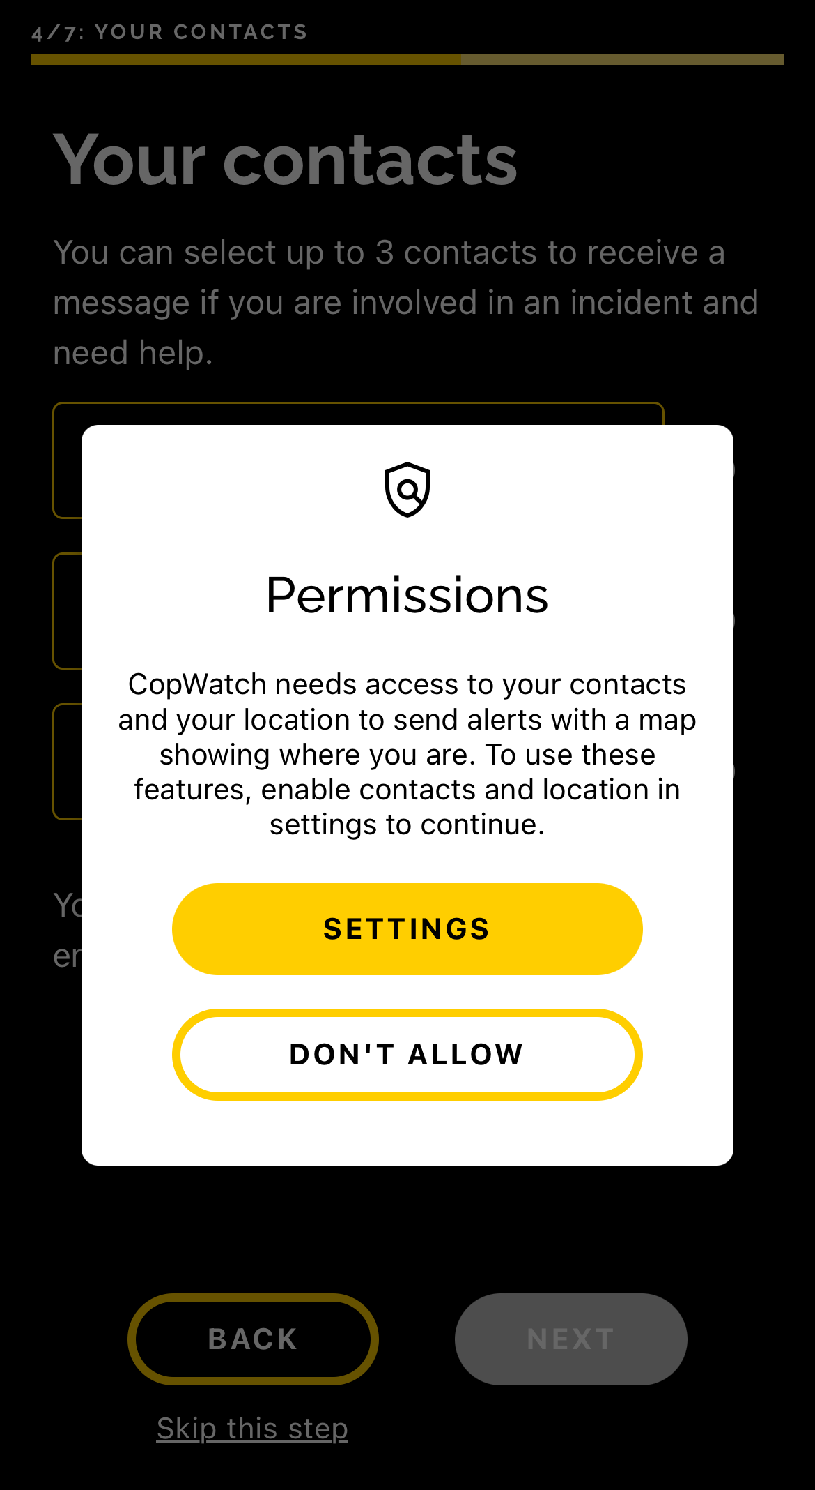
STEP 3 – PERMISSIONS
CopWatch will ask permission to access your:
Camera, microphone and photos – to record and store videos
Contacts – to send alerts to your chosen contacts
Location – to share your location when sending alerts to your chosen contacts
All permissions are optional and can be updated any time in phone settings
COPWATCH
19
Notes:
STEP 3 – PERMISSIONS
During the setup process, the app will request permissions to access apps on your phone:
To record and store videos in your phone gallery, you will need to allow CopWatch to access your camera, microphone and photos (add photos only, for storing videos). Videos taken using the app are also stored in the app.
To send alerts to your contacts, you will need to allow CopWatch to access your contacts.
To share your location with your chosen contacts when you alert them, you will need to allow CopWatch to access your location. There are different access options to choose from. We recommend ‘allow while using the app’.
The app works best when you accept all permissions, but this is not mandatory (required) to use the app.
The CopWatch app does not collect or have access to any data on your phone. It just allows you to use all the functions/tools in the app.

Slide 20
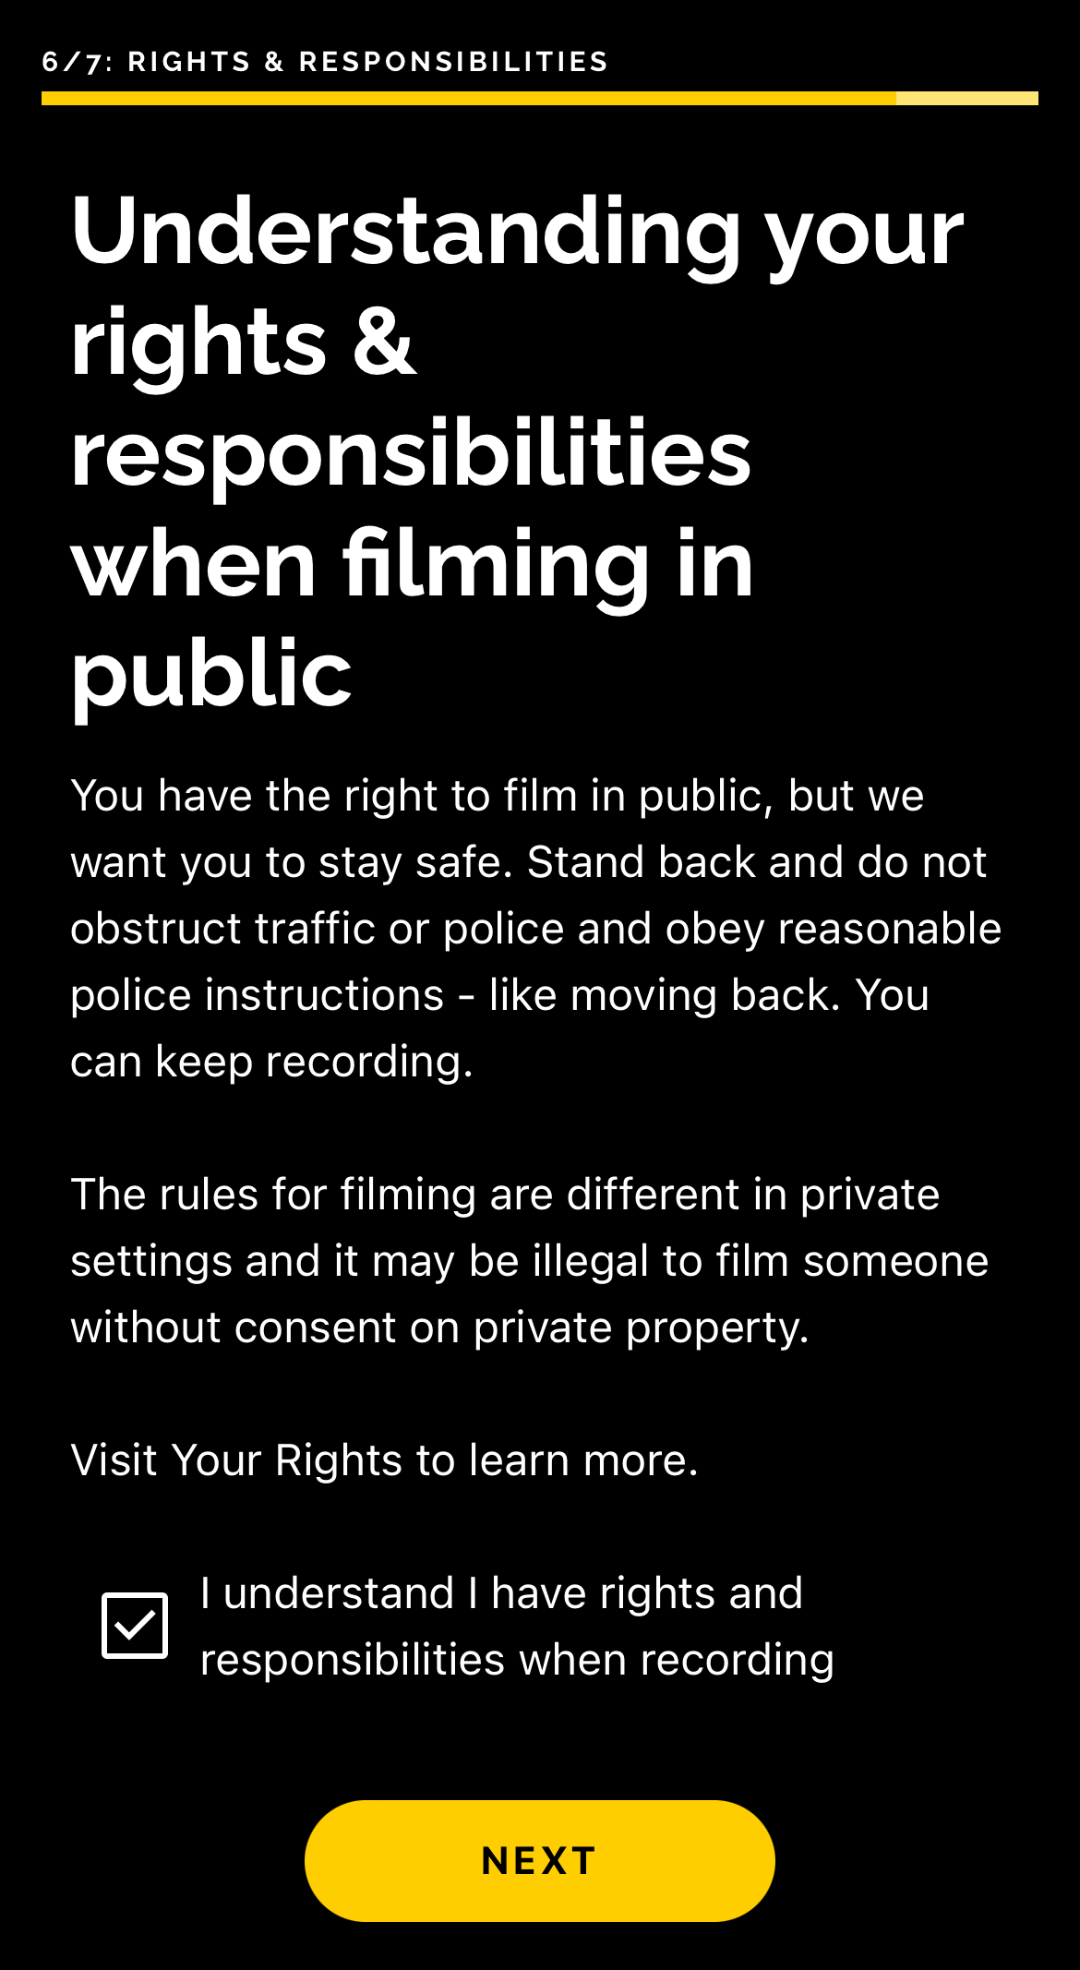
STEP 4 – YOUR RIGHTS
& RESPONSIBILITIES
Final steps:
Read the statement
Tick the box and click ‘next’
Then click ‘finish’ to start using the app!
COPWATCH
20
Notes:
STEP 4 – GET TO KNOW YOUR RIGHTS & RESPONSIBILITIES
Final steps:
Read the statement
Tick the box and click ‘next’
Then click ‘finish’ to start using the app!
Remember! Police have a broad range of powers:
Get to know your rights and responsibilities when dealing with and filming police in your state/territory
You can select ‘Your Rights’ from the menu bar at the bottom of your screen or visit the CopWatch website any time to learn more: www.copwatch.org.au/rights

Slide 21
USING THE COPWATCH APP
COPWATCH
21

Slide 22
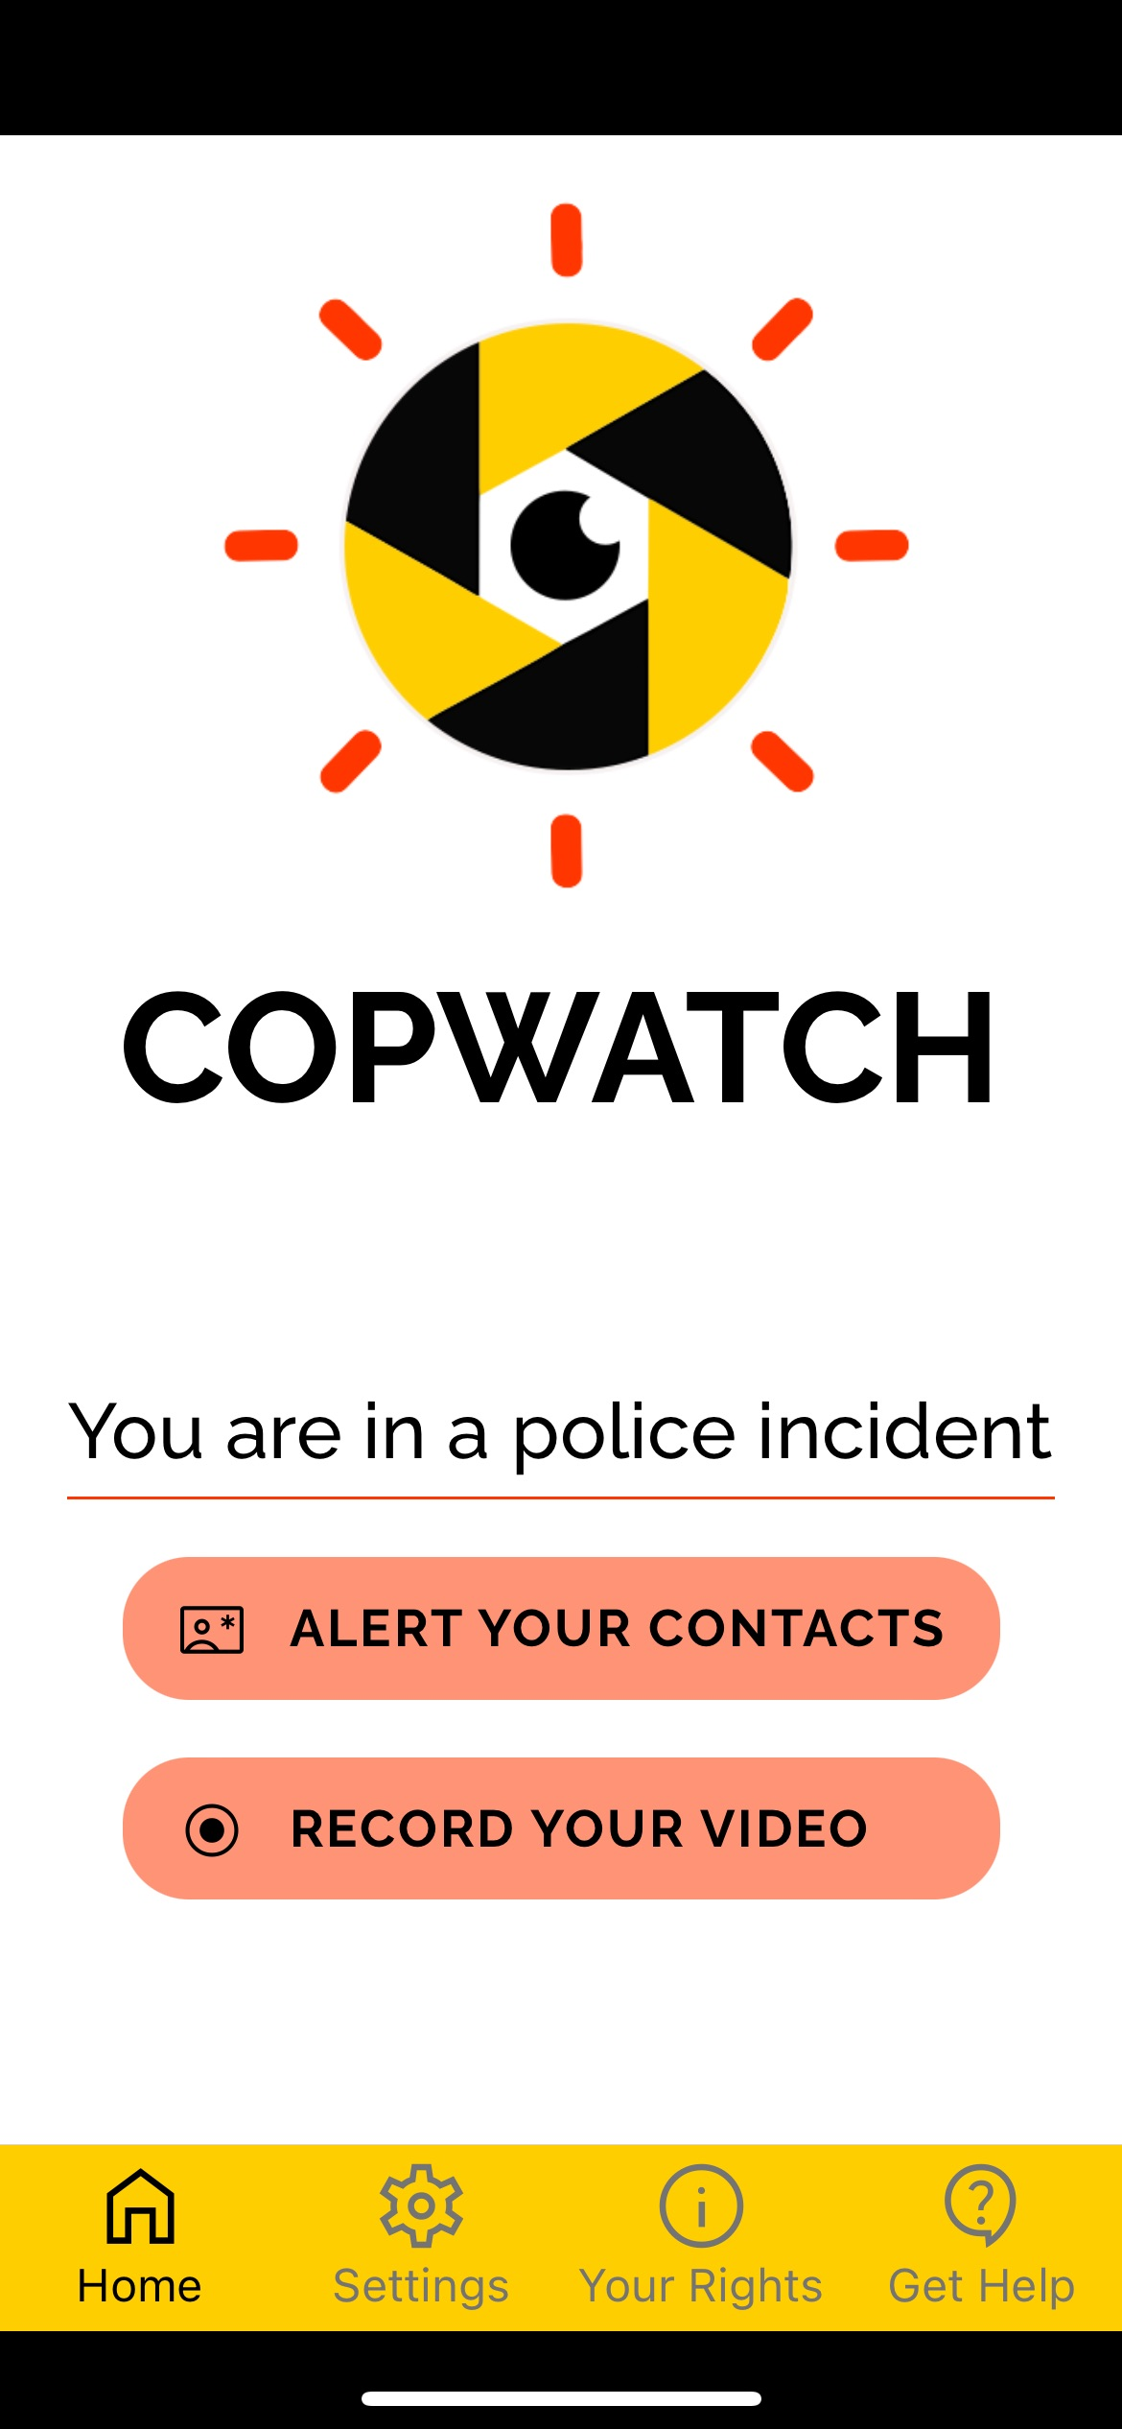
Key features
Alerts your chosen contacts to let them know you need help and shares your location
Films interactions with police
Stores videos safely on your phone and in the app
Safe & Confidential – CopWatch does not collect, share or have access to any of your data or personal info
COPWATCH
22
Notes:
KEY FEATURES OF THE COPWATCH APP
Alerts your chosen contacts to let them know you need help and share your location
Films interactions with police
Stores videos safely on your phone
Links to website for more information on:
Your rights and responsibilities
Support and other services
Safe and confidential – CopWatch does not collect, share or have access to any of your data or personal info
Update your app settings and permissions at any time via app and phone settings

Slide 23
SENDING ALERTS
Click ‘alert your contacts’
An alert will appear in your phone’s messaging app:
I am currently involved in an incident with police and may need your help [at this location]. I sent this with the CopWatch App. Google CopWatch for more information about being a CopWatch contact
Alerts can be edited if needed (or to skip click ‘cancel’)
Alerts only work if you give contact permissions and add at least one contact
Location geo-pin only works if you give location permissions
COPWATCH
23
Notes:
SENDING ALERTS
If you are involved in an incident with the police, are worried about your safety, or you think the police will arrest you, you can use the CopWatch app to send alerts to your chosen contacts (with permissions)
Once you have added your contact/s, simply click ‘alert your contacts’ on the CopWatch app home page.
An alert will appear in your phone’s messaging app: “I am currently involved in an incident with police and may need your help [at this location]. I sent this with the CopWatch App. Google CopWatch for more information about being a CopWatch contact.”
Alerts are sent from your phones default messaging app and can be edited before sending if needed
You can skip by clicking cancel. This will take you back to the app’s home page
Alerts only work if you give contact permissions and and have added at least one contact
The location geo-pin only works if you give location permissions
Once you finish sending your message/s (or click cancel), you are automatically taken back to the app so that you can start filming

Slide 24
MANAGING YOUR INFO & VIDEOS
Go to CopWatch app settings to:
Edit your name and contacts
Manage your video storage:
Videos are stored automatically in the CopWatch app and your phone's photo/video gallery (with permissions)
Restore videos to your phone’s gallery by clicking ‘Restore videos’ and selecting ‘restore’
Delete all videos from the app by clicking ‘Delete Video Storage’ and selecting ‘delete’. All videos will be deleted permanently from the app and cannot be restored later
COPWATCH
24
Notes:
MANAGING YOUR INFO & VIDEOS
From the CopWatch app settings, you can:
Edit your name and select contacts
Manage your video storage:
CopWatch videos are stored automatically in the CopWatch app and in your phone's default photo/video gallery (with permissions)
Restore: If a video is deleted from your phone's gallery, it is still stored securely in the app and can be restored to your phone’s gallery by clicking ‘Restore videos’ and selecting ‘restore’
Delete: If you delete videos from the CopWatch app, all videos stored in the app are deleted and cannot be restored later. Note: This action will not delete any videos saved to your phone’s gallery.

Slide 25
PROTECTING YOUR VIDEOS
Uploading to the cloud helps protect your videos if your phone is lost or damaged
Some cloud services may be included in your phone plan, others cost money. Free options include:
Note: instant and network backup options use mobile data ($$$)
Apple iCloud Drive (5 GB free) | Google Drive (15 GB free)
Microsoft Drive (5 GB free) | DropBox (2 GB free)
IDrive (10 GB free)
COPWATCH
25
Notes:
PROTECTING YOUR VIDEOS
You can protect your videos by backing up your phone’s photo/video gallery to your chosen cloud service
Uploading to the cloud helps protect your videos if your phone is lost or damaged
Some cloud services may be included in your phone plan. Others generally cost money. Some providers may have a free limited option (more space requires a paid subscription), eg:
Apple iCloud Drive (5 GB free)
Microsoft Drive (5 GB free)
IDrive (10 GB free)
Google Drive (15 GB free)
DropBox (2 GB free)
Check your provider's website to configure your phone set-up correctly, including eg:
Backup using Wi-Fi, or network (mobile data)
Backup daily, or instantly (mobile data)

Slide 26
FILMING POLICE
SECTION OVERVIEW
Filming Police in Public
Filming Police in Private
Making & Sharing Videos
Protecting Your Phone & Videos
COPWATCH
26
Notes:
[EDIT THIS SLIDE AND THE SLIDES IN THIS SECTION AS NEEDED ACCORDING TO YOUR TRAINING AGENDA, LOCATION & GROUP]

Slide 27
FILMING POLICE IN PUBLIC
COPWATCH
27

Slide 28
FILMING POLICE IN PUBLIC
You have a legal right to film police if:
it is in a public place, and
you are not interfering with police duties
BUT even in public some things are always against the law to film, like:
military sites, acts of stalking or upskirting
where there is an expectation of privacy (eg bathrooms, change rooms)
Police cannot tell you to stop filming and you do not have to stop filming just because they ask/tell you to stop
BUT recording phone conversations with the police is generally against the law
COPWATCH
28
Notes:
FILMING POLICE IN PUBLIC
You have a legal right film police if it’s in a public place and you are not interfering with/getting in the way of police duties. The rules are different when filming in private settings. [This is covered in detail below at ‘Filming in Private’]
A public place is a social space that is open and accessible to everyone (eg sidewalk, park)
You have a right to film in public BUT there are still things that are against the law to film, like military sites and acts of stalking or upskirting, or where there is an expectation of privacy (eg bathrooms, changerooms)
Police cannot tell you to stop filming and you do not have to stop filming just because they ask/tell you to stop filming
BUT the same rules don’t apply to recording phone conversations with the police, which is generally against the law.

Slide 29
FILMING POLICE IN PRIVATE
COPWATCH
29

Slide 30
FILMING POLICE IN PRIVATE
In all states and territories:
There are more rules when filming in private than in public
‘Private’ can mean private spaces (eg homes, shops, schools etc) or situations where there’s an expectation of privacy (eg private conversations in public places)
As a general rule, you can only film in a private situation if everyone who is there agrees to it
BUT each state/territory has their own rules for filming in private without permission
COPWATCH
30
Notes:
FILMING POLICE IN PRIVATE
In all states and territories:
There are more rules when filming in private than there are in public.
This includes private spaces (like homes, shops, schools etc) or situations where there’s an expectation of privacy (eg private conversations in public places). [See below examples of private conversations, if needed]
As a general rule, you can only film in a private situation if you have got everyone who is there’s permission.
Also, if you’re on private property and the owner/renter asks you to leave or to stop recording you must do as they ask.
However, each state/territory has their own rules for filming in private without permission…
[SEE BELOW SLIDES FOR ADDITIONAL RULES SPECIFIC TO YOUR STATE/TERRITORY]
Examples of private conversations:
A conversation between two people at low volume in a busy park where there is no one close to them would be a private conversation.
A conversation between two people taking place in a private home where they are alone would be a private conversation.
A conversation between two people in a crowded food court that is loud enough for the people sitting next to them to hear would not be private.
DEFINITIONS:
Private conversation: It is a private conversation or activity if the people involved expect it to stay private between them (eg if they are the only people in the room or if they are whispering). You are considered a party to a private conversation if words are spoken by you or to you during the conversation.
Private place: A place which belongs to someone else and isn’t open to the public without invitation (eg someone’s backyard). It’s usually an area that belongs to a business, person or family, and not everyone is allowed to go there without their permission.
Permission of landowner: While you may not need permission from the person who owns or rents the private property to start filming, if the landowner or responsible person requests that you stop filming, you must stop filming. For example, if you are you are at a party in someone’s backyard and you are filming and the person living there asks you to stop filming you should do as they ask and stop filming.

Slide 31
FILMING IN PRIVATE IN YOUR STATE/TERRITORY
COPWATCH
31
Notes:
[EDIT THE SLIDES IN THIS SECTION AS NEEDED ACCORDING TO YOUR LOCATION/COMMUNITY]

Slide 32
Australian Capital Territory (ACT) New South Wales (NSW) Tasmania (TAS)
If you don’t have everyone’s permission, then you can only film in a private situation IF:
you are part of the conversation/situation
you think the video is needed to protect your rights
you are not planning to share the video with others
You are ‘part of the conversation/situation’ if words are spoken by you or to you during the conversation
COPWATCH
32
Notes:
[EDIT THE HEADINGS IN THIS SLIDE AS NEEDED SO THAT IT IS RELEVANT FOR YOUR LOCATION/COMMUNITY]
In the Australian Capital Territory (ACT), New South Wales (NSW) & Tasmania (Tas):
If you don’t have everyone’s permission, then you can only film in a private situation IF:
you are part of the conversation/situation
you think the video is needed to protect your rights
you are not planning to share the video with others
You are ‘part of the conversation/situation’ if words are spoken by you or to you during the conversation

Slide 33
Northern Territory (NT) Victoria (VIC)
If you don’t have everyone’s permission, then you can only film in a private situation IF:
you are part of the conversation/situation
You are ‘part of the conversation/situation’ if words are spoken by you or to you during the conversation
COPWATCH
33
Notes:
[EDIT THE HEADINGS IN THIS SLIDE AS NEEDED SO THAT IT IS RELEVANT FOR YOUR LOCATION/COMMUNITY]
In the Northern Territory (NT) & Victoria (Vic):
If you don’t have everyone’s permission, then you can only film in a private situation IF:
you are part of the conversation/situation
You are ‘part of the conversation/situation’ if words are spoken by you or to you during the conversation

Slide 34
Queensland (QLD)
If you don’t have everyone’s permission, then you can only film in a private situation IF:
you are part of the conversation/situation, and
you do not share the video with others
You are ‘part of the conversation/situation’ if words are spoken by you or to you during the conversation
COPWATCH
34
Notes:
In Queensland (Qld):
If you don’t have everyone’s permission, then you can only film in a private situation IF:
you are part of the conversation, and
you do not share the video with others (ie once the conversation has been recorded, the recording cannot be shared with anyone who wasn’t a part of the original conversation)
You are ‘part of the conversation/situation’ if words are spoken by you or to you during the conversation

Slide 35
South Australia (SA) Western Australia (WA)
If you don’t have everyone’s permission, then you can only film in a private situation IF:
the video is in the ‘public interest’ (eg you are filming a serious crime as evidence), or
you are filming to protect the rights (‘lawful interest’) of the person being filmed (eg if a person has a genuine fear for their safety)
BUT ‘public interest’ and ‘lawful interest’ can be tricky – so get legal help first
COPWATCH
35
Notes:
[EDIT THE HEADINGS IN THIS SLIDE AS NEEDED SO THAT IT IS RELEVANT FOR YOUR LOCATION/COMMUNITY]
In South Australia (SA) & Western Australia (WA):
If you don’t have everyone’s permission, then you can only film in a private situation IF:
the video is in the ‘public interest’ – eg you are filming a serious crime as evidence, or
you are filming to protect the rights (or ‘lawful interest’) of the person being filmed (eg if a person has a genuine fear for their safety)
BUT ‘public interest’ and ‘lawful interest’ can be tricky – so get legal help first
LEGAL DEFINITIONS:
A ‘public interest’ may include recordings made as evidence made of the commission of a serious offence
A 'lawful interest' may include if a person has a genuine fear for their safety. However, it may not include recordings designed to gain an advantage in civil or family proceedings
Important note: what constitutes a ‘lawful interest’ or a ‘public interest’ will ultimately need to be objectively determined based on the specific circumstances in which the recording is made. We recommended getting legal advice before trying to record a conversation without permission/consent in order to protect the 'public interest’ or protect the ‘lawful interest’ of a person.

Slide 36
FILMING POLICE IN PUBLIC & PRIVATE
ACTIVITY
COPWATCH
36
Notes:
[YOU CAN ADD YOUR CHOSEN SCENARIOS, DISCUSSION POINTS & TIPS TO THE SLIDES AND/OR SLIDE NOTES HERE. SEE THE TRAINER GUIDE DOCUMENT FOR ACTIVITY SUGGESTIONS]

Slide 37
MAKING & SHARING VIDEOS
COPWATCH
37
Notes:
[EDIT THIS SLIDES IN THIS SECTION AS NEEDED ACCORDING TO YOUR TRAINING AGENDA & YOUR COMMUNITY/GROUP]

Slide 38
TIPS FOR MAKING A VIDEO…
Where possible and safe, try to:
Stand back/keep at a safe distance from police
Follow reasonable instructions, like ‘move back’ – you can keep filming
Focus on what police are saying and doing
Hold your phone sideways (landscape)
Keep filming for as long as you can
Record identifying details (eg number plates, badges, street signs)
COPWATCH
38
Notes:
TIPS FOR MAKING A VIDEO (continues next slide)
Where possible and safe to do so, try to:
Stand back/keep at a safe distance from police
Follow reasonable instructions, like ‘move back’ – you can keep filming
Focus on what police are saying and doing
Hold your phone sideways (landscape) and close to your chest pointing out towards the incident
Keep filming for as long as possible (for evidence of the entire uninterrupted interaction)
Try to record identifying details, eg number plates, badges, street signs etc (if possible and from a safe distance)
More information on video as evidence (repeats on next slide):
Video evidence may support any defence case that arises or even support proceedings against the police if necessary and appropriate.
For videos to be used as evidence in court:
Videos must have a clear chain of custody:
Never edit or change the original video
Save the original copy somewhere safe
You must be able to prove it is what you say it is:
Record identifying details like street signs, number plates and badges (if possible/safe)
Recordings that can be used as evidence are important because:
It proves what actually happened
It ultimately holds police accountable for their actions and getting justice
BUT don’t forget it can also incriminate!!

Slide 39
… TIPS FOR MAKING A VIDEO
… Where possible and safe, try to:
Move slowly
Don’t zoom in/out too much
Don’t talk over what’s happening
State the date, time and location on video
COPWATCH
39
Notes:
TIPS FOR MAKING A VIDEO (continued from previous slide)
…Where possible and safe, try to:
Move slowly and try not to zoom in/out too much
Don’t speak over what’s happening while filming (if possible)
Before stopping filming, state the date, time and location directly to the camera (if possible)
Practice filming! The more practice you get, the more prepared you will be if/when the time comes.
More information on tips for keeping safe and gathering evidence:
The most important thing is your safety. Getting too close may be used to arrest, charge or fine you for interfering in police work, or worse you may experience police violence.
The most important thing to record/film is what police are saying and doing. Even if it looks like things have calmed down and nothing too exciting is happening, keep filming police – anything can happen and sometimes police behave better if they are being filmed (but sadly not always!)
Police officers should wear name tags and badge numbers to help identify them. You can also read their names and numbers on camera, which can help identify individual officers later.
Don't film the person being stopped unless it is to show what officers are doing to them. You want to avoid gathering evidence for police, even if accidentally.
If police think you have video evidence of a crime on your camera phone, police can take it as evidence, even if the person who made the video is is not a suspect.
More information on video as evidence:
Video evidence may support any defence case that arises or even support proceedings against the police if necessary and appropriate.
For videos to be used as evidence in court:
Videos must have a clear chain of custody:
Never edit or change the original video
Save the original copy somewhere safe
You must be able to prove it is what you say it is:
Record identifying details like street signs, number plates and badges (if possible/safe)
Recordings that can be used as evidence are important because:
It proves what actually happened
It ultimately holds police accountable for their actions and getting justice
BUT don’t forget it can also incriminate!!

Slide 40
BEFORE SHARING VIDEOS
Important things to think about before sharing and posting your videos:
Think VERY carefully before sharing videos and posting online – you never know where it will end up or how it might be edited and used
Remember, you and your friends will be filmed too, and this can be used as evidence against you!
Think about who else is in the video. How would they feel about it? Does it show them committing an offence?
Is it against the law to publish or share your video?
Get legal advice before sharing
COPWATCH
40
Notes:
BEFORE SHARING & POSTING VIDEOS
Important things to think about before sharing and posting your videos:
Think VERY carefully before publishing or sharing your recording online. You never know where it will end up or how it might be edited and used
Remember, you and your friends will be recorded too, and this can be used as evidence against you!
Think about who else is in the recording:
Does it show someone committing an offence?
How would they feel about seeing themselves on online?
How would you/they feel if it went viral?
Does it embarrass anyone?
Are there cultural issues you need to consider?
Is it against the law to publish?
It’s always a good idea to get legal advice before sharing, especially if you plan to make a complaint or take legal action
[A full list of legal and support services and other useful resources/links are available on the CopWatch website at: www.copwatch.org.au/legal-help]

Slide 41
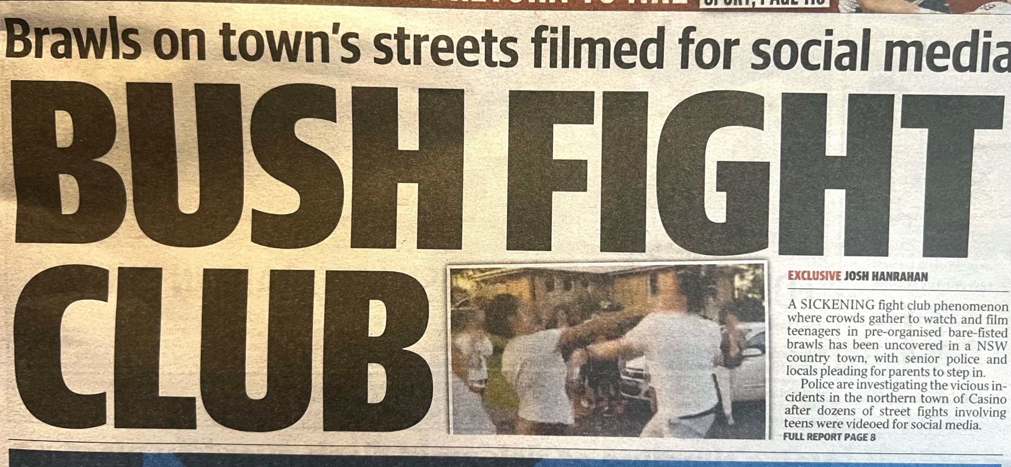
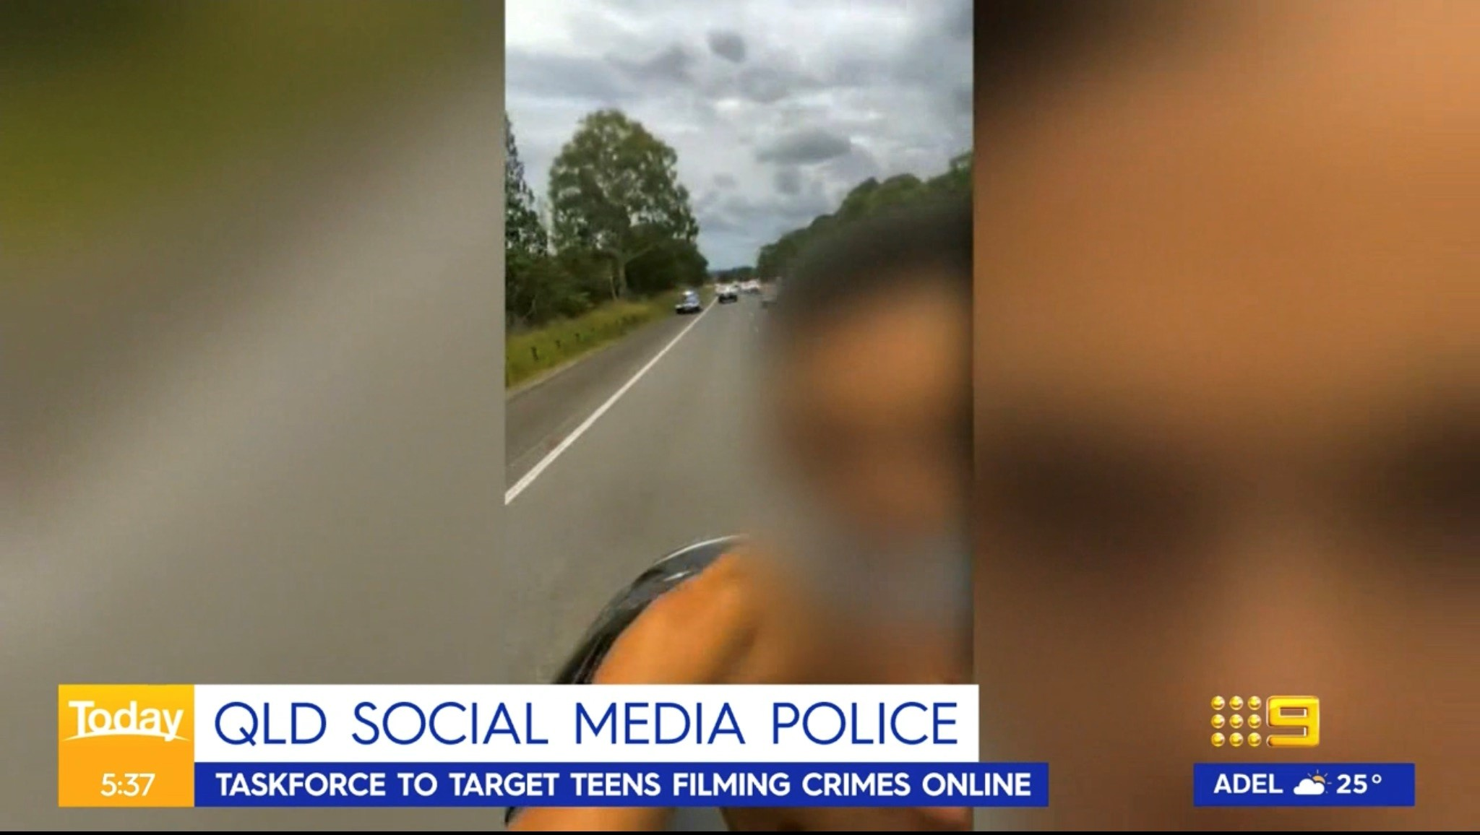
BEFORE SHARING VIDEOS
COPWATCH
41
Notes:
[EDIT THIS SLIDE/NOTES AS NEEDED ACCORDING TO YOUR TRAINING AGENDA, LOCATION & COMMUNITY/GROUP]
THINK BEFORE SHARING & POSTING VIDEOS
Police are using social media to search for evidence of crimes.
For example, recent changes to the law in Queensland (Feb-2023) means that posting footage online of stealing a car or driving aggressively can lead to more time behind bars (up to 12 years for adults; up to 6 years for kids)
Queensland police have also been given extra funding/resources to search through social media looking for evidence of crimes.
Source: https://www.abc.net.au/news/2023-03-16/qld-youth-crime-laws-parliament-pass-explained-bail-court/102089826

Slide 42
MAKING A VIDEO
ACTIVITY
COPWATCH
42
Notes:
[YOU CAN ADD YOUR CHOSEN SCENARIOS, DISCUSSION POINTS & TIPS TO THE SLIDES AND/OR SLIDE NOTES HERE. SEE THE TRAINER GUIDE DOCUMENT FOR ACTIVITY SUGGESTIONS]

Slide 43
PROTECTING YOUR PHONE & VIDEOS
COPWATCH
43

Slide 44
YOUR RIGHTS
Police can’t take your phone without a lawful reason
Police are never allowed to delete anything from your phone (videos, images, apps, texts etc)
Without a warrant, police can’t:
Take or search your phone unless you give them permission – NEVER give permission!
Make you unlock your phone
Make you give them your passcode
Physically force you to unlock your phone
Demand access to your phone or contents if it is passcode protected
COPWATCH
44
Notes:
YOUR RIGHTS
Police can’t take your phone without a lawful reason
Police are never allowed to delete anything from your phone (videos, images, apps, texts etc).
Without a warrant, police can’t:
Take or search your phone unless you give them permission
Never give police permission! If you do, challenging any evidence is very difficult.
If a police officer tries to, or does, take your phone – it can be an offence, so note down what happened.
Make you unlock your phone
Make you give them your pass code
Physically force you to unlock your phone (including fingerprint/facial recognition)
Demand access to your phone or contents if it is passcode protected.
If a police officer tries to, or does, take your phone – it can be an offence, so note down what happened.
More information on lawful reasons (repeats on next slide):
The police have a warrant: Police usually need a warrant to search your possessions or property. If the warrant includes your phone, the police can take it and examine its contents.
The police arrest you: If you get arrested, the police can search you and take your things. This does not always mean the police have power to search the contents of your phone. If you’re arrested, they can take your belongings ONLY while you’re in custody.
If the police believe you have committed a crime: In some limited situations, the police can search you without a warrant and take your things, including your phone, if they believe your phone is connected to a crime you might have committed.
If the police believe you have made an illegal recording: Even though you can usually record things in public, if you have made an illegal recording, the police may have the power to take your phone. There are not many circumstances where it is unlawful to make a recording, so this should not happen.
Preserving Evidence: If the police believe that your property is or contains evidence of a crime, they may be able to take it to ensure evidence is not destroyed or lost. This may include evidence stored on your phone or recording device. Police can take your phone as evidence EVEN if you do not consent.
For example, if the police think your phone is stolen, they can take it.
If the phone contains evidence to show someone committed a crime, like footage of someone hitting someone else.

Slide 45
POLICE POWERS
Police can take your phone:
if they have a warrant
if you’re under arrest
if they believe you have committed a crime or made an illegal recording
to preserve evidence (eg if they think you have filmed evidence of a crime)
BUT this does not give police the right to access your phone’s contents, and you do not have to give them your passcode – they need a special warrant
COPWATCH
45
Notes:
POLICE POWERS
Police can't take your phone just because they dislike your recording. Generally, they must have a lawful reason to take your phone, for example:
If they have a warrant
If you’re under arrest
If they believe you have committed a crime or made an illegal recording
To preserve evidence (eg if police think you have filmed evidence of a crime, even if you are not involved in the crime).
BUT this doesn’t give them the right to access its contents, and you don’t have to give them your passcode – they need a special warrant.
More information on lawful reasons:
The police have a warrant: Police usually need a warrant to search your possessions or property. If the warrant includes your phone, the police can take it and examine its contents.
The police arrest you: If you get arrested, the police can search you and take your things. This does not always mean the police have power to search the contents of your phone. If you’re arrested, they can take your belongings ONLY while you’re in custody.
If the police believe you have committed a crime: In some limited situations, the police can search you without a warrant and take your things, including your phone, if they believe your phone is connected to a crime you might have committed.
If the police believe you have made an illegal recording: Even though you can usually record things in public, if you have made an illegal recording, the police may have the power to take your phone. There are not many circumstances where it is unlawful to make a recording, so this should not happen.
Preserving Evidence: If the police believe that your property is or contains evidence of a crime, they may be able to take it to ensure evidence is not destroyed or lost. This may include evidence stored on your phone or recording device. Police can take your phone as evidence EVEN if you do not consent.
For example, if the police think your phone is stolen, they can take it.
If the phone contains evidence to show someone committed a crime, like footage of someone hitting someone else.

Slide 46
TIPS FOR PROTECTING YOUR PHONE
To protect your phone from police:
Turn off fingerprint/facial recognition and lock it with a passcode that is hard to guess
Never unlock your phone for police, unless they show you a warrant or digital access order
If you are unsure or worried, always speak to a lawyer before unlocking your phone for police
COPWATCH
46
Notes:
TIPS FOR PROTECTING YOUR PHONE
To protect your phone from police:
Turn off fingerprint/facial recognition on your phone and lock it with a passcode that’s hard to guess.
Never unlock your phone without the police showing you a warrant or digital access order.
If you’re unsure or worried, always speak to a lawyer before unlocking your phone for police.
Never consent to police searching your phone or your stuff (but follow their orders to avoid fines/charges and harm).

Slide 47
PROTECTING YOUR PHONE & VIDEOS
ACTIVITY
COPWATCH
47
Notes:
[YOU CAN ADD YOUR CHOSEN SCENARIOS, DISCUSSION POINTS & TIPS TO THE SLIDES AND/OR SLIDE NOTES HERE. SEE THE TRAINER GUIDE DOCUMENT FOR ACTIVITY SUGGESTIONS]

Slide 48
DEALING WITH POLICE
SECTION OVERVIEW
Stopped & Questioned by Police
Stopped & Searched by Police
Police Misconduct & Making a Complaint
COPWATCH
48
Notes:
[EDIT THIS SLIDE AND THE SLIDES IN THIS SECTION AS NEEDED ACCORDING TO YOUR TRAINING AGENDA, LOCATION & GROUP]

Slide 49
STOPPED & QUESTIONED BY POLICE
COPWATCH
49

Slide 50
TIPS FOR KEEPING SAFE…
Remember, police have a broad range of powers!
Tips for keeping safe when dealing with police:
Try to stay calm, be polite and cooperative
Don’t resist, swear etc – this can lead to additional charges or fines
If you don’t know their rank, call them 'Officer’
COPWATCH
50
Notes:
TIPS FOR KEEPING SAFE (continues on next slide)
Remember, police have a broad range of powers!
Tips for keeping safe when dealing with police:
Try to stay calm.
Try to be polite and cooperative – follow reasonable police instructions
Do not resist or swear etc – this could lead to additional charges or fines.
If you do not know the rank of the police officer, call them 'Officer’.
[SEE BELOW SLIDES FOR ADDITIONAL RULES SPECIFIC TO YOUR STATE/TERRITORY]

Slide 51
…TIPS FOR KEEPING SAFE…
Other than answering legally required questions, DO NOT say anything, answer any other questions, or sign anything until you speak to a lawyer – you can say ‘no comment’
Remember, there is no such thing as an ‘off the record’ conversation with police!
Before talking to the police:
children under 18 have a legal right to wait for a trusted adult or lawyer
adults over 18 have a legal right to wait for a lawyer
COPWATCH
51
Notes:
TIPS FOR KEEPING SAFE (continued from previous slide)
Tips for keeping safe when dealing with police:
Other than answering any legally required questions, don’t answer any other questions, volunteer information or sign anything until you speak to a lawyer
If you do not want to answer police questions, you can say 'no comment’.
An interview doesn’t have to happen at a police station to be official, and there is no such thing as an ‘off the record’ conversation with police. They can use what you say against you in court.
If you are under 18 years of age, you have a legal right to wait until a trusted adult or lawyer is with you before talking to the police.
If you are over 18 years of age, you have a legal right to wait until a lawyer is with you before talking to the police.
[SEE BELOW SLIDES FOR ADDITIONAL RULES SPECIFIC TO YOUR STATE/TERRITORY]

Slide 52
…TIPS FOR KEEPING SAFE
In general, when asked you must tell police your name and address, and sometimes your age or date of birth
You may need to prove your personal details by showing your ID (eg licence, student, age or other ID card)
Don’t refuse, lie or give false information – you can be fined or charged
COPWATCH
52
Notes:
TIPS FOR KEEPING SAFE (continued from previous slide)
Tips for keeping safe when dealing with police:
In general, when asked you must give your name, the address where you are living, and in some cases your age/date of birth (DOB)
You may also need to prove your personal details by showing your ID (eg licence, student, age or other ID card)
Don’t refuse, lie or give false information – you can be fined or charged
[SEE BELOW SLIDES FOR ADDITIONAL RULES SPECIFIC TO YOUR STATE/TERRITORY]

Slide 53
YOUR RIGHTS
If you are stopped and questioned by police, you have a legal right to:
Ask police for their name and the station they are from
In South Australia, Queensland & Victoria, police must also provide their rank when asked
If police are not in uniform, they must show you their police badge/identity card or other proof of identity
Ask why they want your details – they must answer
Have a trusted adult with you when questioned by police if you are under 18
COPWATCH
53
Notes:
[EDIT THE state/territory specific information in this slide AS NEEDED SO THAT IT IS RELEVANT FOR YOUR LOCATION/COMMUNITY]
YOUR RIGHTS
If you are stopped and questioned by police, you have a legal right to:
Ask police their name and the station they are from
In South Australia, Queensland and Victoria, police must also provide their rank when asked.
If police are not in uniform, they must show you their police badge/identity cards or other proof of identity.
Ask why they want your details. They must tell you if you ask (if possible, make a note of what they say).
Have a trusted adult with you when questioned by police if you are under 18.
If you're under 18, it’s a good idea to tell them your age as you may have additional rights/protections, like having a trusted adult with you.
[SEE BELOW SLIDES FOR ADDITIONAL RULES SPECIFIC TO YOUR STATE/TERRITORY]

Slide 54
POLICE POWERS…
As a general rule, police can ask for your name, DOB, address or ID:
If you have been given an order to ‘move on’, stop making ‘noise’ or stop being a ‘nuisance’
If you are driving a vehicle (car, boat, motorbike, scooter etc)
If you’re in a pub, bar, hotel or any place that sells alcohol
When they are trying to enforce another law
Where it is reasonable in the circumstances/situation
COPWATCH
54
Notes:
POLICE POWERS (continues next slide)
As a general rule, police have a legal right to ask for your name, DOB, address or identification (ID):
If you have been given an order to ‘move on’, stop making ‘noise’ or stop being a ‘nuisance’
If you are driving a vehicle (car, boat, motorbike, scooter etc)
If you’re in a pub, bar, hotel or other place that sells alcohol
When they are trying to enforce another law
Where it is reasonable in the circumstances/situation
Generally, the officer must warn you that it’s an offence not to give them your correct name and address.
[SEE BELOW SLIDES FOR ADDITIONAL RULES SPECIFIC TO YOUR STATE/TERRITORY]

Slide 55
… POLICE POWERS
Police can also ask for your name, DOB, address or ID:
If you are caught committing an offence/crime
If they think that:
you have committed or you are about to commit an offence/crime
you can help them with an investigation – they must tell you what the offence/crime is that they are investigating
You can be charged or fined if you lie or refuse to show ID without a good reason (eg you don’t have ID or it’s not legally required)
COPWATCH
55
Notes:
… POLICE POWERS (continued from previous slide)
Police also have a legal right to ask for your name, DOB, address where you are living, or some form of identification ID:
If you’re caught committing an offence/crime
If they have a justified genuine belief that:
You have committed or are about to commit an offence/crime
You have information that may be able to assist in the investigation of an offence or a suspected offence
- They must tell you what offence they think you can help them investigate
You can be charged or fined if you lie or refuse to show ID without a good reason (eg you don’t have ID or it’s not legally required)
[SEE BELOW SLIDES FOR ADDITIONAL RULES SPECIFIC TO YOUR STATE/TERRITORY]

Slide 56
POLICE POWERS IN YOUR STATE/TERRITORY
COPWATCH
56
Notes:
[EDIT THE SLIDES IN THIS SECTION AS NEEDED ACCORDING TO YOUR LOCATION/COMMUNITY]

Slide 57
POLICE POWERS – INVESTIGATIONS
In Tasmania (Tas), there is a general requirement to assist police if they think you can help them in the investigation of an offence or a suspected offence
In Queensland (Qld), police can also ask for your name, DOB, address or ID if they think you are hanging out with a known offender (eg bikies)
COPWATCH
57
Notes:
[EDIT THE state/territory specific information in this slide AS NEEDED SO THAT IT IS RELEVANT FOR YOUR LOCATION/COMMUNITY]
POLICE POWERS – INVESTIGATIONS
In Tasmania there is a general requirement to assist a police officer if they think you can help them in the investigation of an offence or a suspected offence. (This includes providing your name, DOB, address or ID when asked. However, they must tell you what the offence/crime is that they are investigating)
In Queensland police can also ask for this info if they think you’re hanging out with a known offender (eg bikies)

Slide 58
POLICE POWERS – AGE/DOB
You DO NOT have to tell the police your age or DOB when asked if you are in:
Australian Capital Territory (ACT)
New South Wales (NSW)
Northern Territory (NT)
Tasmania (Tas)
Victoria (Vic)
You MUST tell police your age or DOB when asked if you are in:
Queensland (Qld)
South Australia (SA)
Western Australia (WA)
COPWATCH
58
Notes:
POLICE POWERS (YOUR AGE & DOB)
You DO NOT have to tell the police your age or date of birth (DOB) when asked if you are in:
Australian Capital Territory (ACT)
New South Wales (NSW)
Northern Territory (NT)
Tasmania (Tas)
Victoria (Vic)
BUT, if you're under 18, it’s a good idea to tell them your age because you have a legal right to wait until a trusted adult or lawyer with you before speaking with police.
You MUST tell police your age or DOB when asked if you are in:
Queensland (Qld)
South Australia (SA)
Western Australia (WA)

Slide 59
POLICE POWERS – ID
In New South Wales (NSW), South Australia (SA) & Queensland (Qld) police can ask you for ID to prove that the information you gave is correct
You can be charged or fined if you lie or refuse to show ID without a good reason (eg you don’t have ID or it’s not legally required)
In the Australian Capital Territory (ACT) & Tasmania (Tas), refusing to show ID without a good reason is a fine and not an offence
COPWATCH
59
Notes:
[EDIT THE state/territory specific information in this slide AS NEEDED SO THAT IT IS RELEVANT FOR YOUR LOCATION/COMMUNITY]
IDENTIFICATION (ID)
In New South Wales, South Australia & Queensland police can ask you for ID to prove that the info you have given them is correct
In other states, you are not legally required to state your age, however it is usually a good idea if you are under 18 especially as you may be entitled to certain protections such as having a trusted adult with you if you are questioned by police.
You can be charged or fined if you lie, or if you refuse to show your ID without a good reason (eg if you don’t have your ID with you, or if you are in a state/territory where there is no legal requirement to show ID under the circumstances)
In the Australian Capital Territory & Tasmania, refusing to comply without a reasonable excuse is a fine and not an offence.

Slide 60
GOING WITH POLICE
Generally, you DO NOT have to go with the police unless you are arrested
BUT if you are under 18 and the police think you should be in school, that you are unsafe, or that someone should be looking after you, then you may have to go with them
You MUST go with police if you are arrested
If you are unsure or worried, ask if you are being arrested and if so on what charge/s – and always ask for a lawyer
COPWATCH
60
Notes:
GOING WITH POLICE
Generally, you do not have to go with the police unless you are arrested
BUT if you are under 18 and the police think you should be in school, that you’re unsafe, or someone should be looking after you, then you may have to go with the them
If you are under arrested.
If you are unsure or worried, ask if you are being arrested and, if so, on what charge
Always ask to speak with a lawyer
[SEE BELOW SLIDES FOR ADDITIONAL RULES SPECIFIC TO YOUR STATE/TERRITORY]

Slide 61
ARRESTED BY POLICE
If you are arrested:
Don’t struggle or resist arrest – this can lead to extra force, charges or fines
If you are under 18, ask to have a responsible/trusted adult with you and don’t say anything until they arrive
If you are over 18, ask for a lawyer and don’t say anything until they arrive
If police use excessive force:
report it to the Police Officer in charge
ask to see a doctor and lawyer
take photos of your injuries if possible (as evidence/proof)
COPWATCH
61
Notes:
ARRESTED BY POLICE
If you are arrested:
Don’t struggle/resist arrest – this can lead to extra force, charges or fines.
If you are under 18, ask to have a responsible/trusted adult with you and don’t say anything until they arrive
If you are over 18, ask for a lawyer and don’t say anything until they arrive
If you are injured or treated with excessive force by police, report it to the Police Officer in charge of the station, see a doctor and lawyer as soon as possible and ask them to take photos of your injuries (to collect evidence/proof)
[SEE BELOW SLIDES FOR ADDITIONAL RULES SPECIFIC TO YOUR STATE/TERRITORY]
More information on situations when police can arrest you:
Police can ONLY arrest you if:
They think you committed a crime/breached your bail
You are ‘breaching the peace’
They have a warrant
If they think you have breached an AVO (Apprehended Violence Order)
More information on use of force:
Police have power to arrest and use reasonable force.
That means they can be ‘reasonably’ physical or forceful with you and it isn’t assault.
But it has to be ‘reasonable’ otherwise it is illegal.
If you struggle, resist, or try to fight the police, they can use extra force.

Slide 62
STOPPED & QUESTIONED BY POLICE
ACTIVITY
COPWATCH
62
Notes:
[YOU CAN ADD YOUR CHOSEN SCENARIOS, DISCUSSION POINTS & TIPS TO THE SLIDES AND/OR SLIDE NOTES HERE. SEE THE TRAINER GUIDE DOCUMENT FOR ACTIVITY SUGGESTIONS]

Slide 63
STOPPED & SEARCHED BY POLICE
COPWATCH
63

Slide 64
TIPS FOR KEEPING SAFE
Tips for keeping safe when searched by police:
Stay calm and respectful – swearing or resisting can lead to fines or charges
You’re allowed to ask why they want to search you
You’re allowed to say that you don’t consent to being searched
If you are under 18, always ask for a parent/guardian or support person to be with you
Never give police consent for a search, but always cooperate
Always ask for someone of the same gender as you to conduct the search
If you feel like you’re being treated unfairly, you can make a complaint and get legal help (more on this later!)
It’s a good idea to take notes of what’s happened to help you remember
COPWATCH
64
Notes:
TIPS FOR KEEPING SAFE
Tips for keeping safe when searched by police:
Try to stay calm and respectful – swearing or resisting can lead to fines or charges
You’re allowed to ask why they want to search you
You’re allowed to say that you don’t consent to being searched
If you are under 18, always ask for a parent/guardian or support person to be with you
Never give police consent for a search, but always cooperate.
Always ask for someone of the same gender as you to conduct the search
If you feel like you’re being treated unfairly, you can make a complaint and get legal help. [For mor information see below slides at ‘Police Misconduct & Making a Complaint’]
It’s a good idea to take notes of what’s happened to help you remember what happened
[SEE BELOW SLIDES FOR ADDITIONAL RULES SPECIFIC TO YOUR STATE/TERRITORY]

Slide 65
TYPES OF SEARCHES…
Ordinary (basic) searches
A police officer can ask you to remove your outer clothes (eg coat/jacket, gloves, shoes, socks, hat) and examine them
Frisk (or pat-down) searches
A police officer can quickly pat down the outside of your clothes.
They can also check your outer clothes and any pocket and bags for guns, knives or other items
* Both basic and frisk searches can be done in public
COPWATCH
65
Notes:
TYPES OF SEARCHES… (continues next slide)
In general, there are three types of searches:
Ordinary (basic) searches: A police officer can ask you to remove your outer clothes (eg coat/jacket, gloves, shoes, socks, hat) and examine them.
Frisk (or pat-down) searches: A police officer can quickly pat down the outside of your clothes. They can also check your outer clothes and any pockets or bags for guns, knives or other items.
* Both basic and frisk searches can be done in public.
[SEE BELOW SLIDES FOR ADDITIONAL RULES SPECIFIC TO YOUR STATE/TERRITORY]

Slide 66
… TYPES OF SEARCHES
Strip searches
A police officer can ask you to remove all or some of your clothes
BUT in almost all cases they can’t search your private areas unless you have been arrested or they have permission from the court
Strip searches must be done in a private place and by an officer of the same gender/sex as you when possible
COPWATCH
66
Notes:
…TYPES OF SEARCHES (continued from previous slide)
Strip searches:
A police officer can ask you to remove all or some of your clothes but in almost all cases they can’t search your private areas unless you have been arrested or they have permission from the court.
Strip searches must be done in a private place and by an officer of the same gender/sex as you when possible.
[SEE BELOW SLIDES FOR ADDITIONAL RULES SPECIFIC TO YOUR STATE/TERRITORY]

Slide 67
POLICE POWERS –
WHEN POLICE CAN SEARCH YOU
Generally, if the police don’t arrest you and they don’t have a warrant, they can still search you if you give consent*, or if they think you are in possession of:
Weapons (guns, knives)
Illegal drugs
Stolen items
Evidence of a crime
* NEVER consent to a police search, but always cooperate to avoid force, fines or charges
COPWATCH
67
Notes:
POLICE POWERS – WHEN POLICE CAN SEARCH YOU
Generally, if the police don’t arrest you and they don’t have a warrant, they can still search you if you consent*, or if they think you have things like:
weapons (guns, knives)
illegal drugs
stolen items
evidence of a crime
* Never consent to a police search, but always cooperate to avoid fines/charges and/or use of force.
More information on reasonable grounds for a search:
Being at a community event or location, such as a music festival, shopping centre or skate park does not automatically give police the right to search you.
Police must consider additional evidence like time and location, the persons behaviour, criminal record or other information known to the police.
A sniffer dog indicating that a person has drugs can provide reasonable grounds.
If it is proven in court that police did not have a genuinely reasonable suspicion, a search may be illegal (and therefore any items found may not be able to be used against you), and any force used may be an assault.
[SEE BELOW SLIDES FOR ADDITIONAL RULES SPECIFIC TO YOUR STATE/TERRITORY]

Slide 68
POLICE SEARCHES IN YOUR STATE/TERRITORY
COPWATCH
68
Notes:
[EDIT THE SLIDES IN THIS SECTION AS NEEDED ACCORDING TO YOUR LOCATION/COMMUNITY]

Slide 69
Australian Capital Territory (ACT)
Police can also search you without a warrant if:
they think you have evidence relating to a serious crime or stolen property, and
they have to search you to stop that thing from being hidden, lost or destroyed, and
the situation is serious and urgent
OR if they think you have a knife in a public place or school
You can’t be strip searched if you’re under 10
If you are under 18, police can’t strip search you unless they have arrested you or they have permission from the court. A parent or carer should be with you
Frisk and strip searches must be done by someone of the same sex as you (police officer, other authorised person)
COPWATCH
69
Notes:
In the Australian Capital Territory:
Police can also search you without a warrant if:
they think you have evidence relating to a serious crime or stolen property; and
they have to search you to stop that thing from being hidden, lost or destroyed; and
the situation is serious and urgent
Or they think you have a knife in a public place or school
You can’t be strip searched if you’re under 10 years of age.
If you are under 18, police can’t strip search you unless they have arrested you or they have a permission from the court. A parent or carer should be with you.
Frisk and strip searches must be done by someone of the same sex as you (police officer, other authorised person)

Slide 70
New South Wales (NSW)
Strip searches must be done by someone the same sex as you (police officer, doctor, nurse, other authorised person)
Police must not search your genital area (including a female or transgender person’s breasts) unless it is necessary for the search
Police must not question you during the search
Children under 18 with cognitive disability must have a parent/guardian or support person with them during a strip search
COPWATCH
70
Notes:
In New South Wales:
Strip searches must be done by someone the same sex as you (police officer, doctor, nurse, other authorised person)
Police must not search your genital area (including a female or transgender person’s breasts) unless it is necessary for the search.
Police must not question you during the search.
Children under 18 with cognitive disability must have a parent/guardian or support person with them during a strip search.

Slide 71
Northern Territory (NT)
Police can also search you without a warrant if they think you have:
non-illegal items that can be inhaled to get high
something connected to a crime (eg item/s that can be used for breaking into houses, stealing cars, making or taking drugs)
Police can use ‘reasonable’ force to search you if they have a legal reason to search you and you don’t cooperate
If you are female, strip searches must be done by a female police officer, doctor, nurse, or other authorised person
If you’re under 18, police can search you without a parent/guardian or support person if:
it’s urgent
delays could put you or another person in danger, or
delays may cause evidence to be lost or destroyed
COPWATCH
71
Notes:
In the Northern Territory:
Police can search you without a warrant if they think you have:
Non-illegal substances that can be inhaled to get high
Something connected with a crime (eg something that can be used for breaking into houses, stealing cars or making or taking drugs)
Police can use reasonable force to search you if they have a legal reason to search you and you don’t cooperate.
If you are female, strip searches must be done by a female police officer, doctor, nurse, or other authorised person.
If you’re under 18, police can search you without a parent/guardian or support person where:
The search needs to be carried out urgently
Delaying the search could put you or another person in danger, or
Delaying the search may cause evidence to be lost or destroyed.

Slide 72
Queensland (QLD)
Police can also search you without a warrant if they think you have:
stolen property
evidence for certain serious crimes
something that can be used to hurt yourself or others
Strip searches must be done by someone the same sex as you (police officer, doctor, other authorised person)
COPWATCH
72
Notes:
In Queensland:
Police can also search you without a warrant if they think you have:
stolen property
evidence for certain serious crimes
something that can be used to hurt yourself or others
Strip searches must be done by someone the same sex as you (police officer, doctor, other authorised person)

Slide 73
South Australia (SA)
Police can also search you without a warrant if they think you have:
evidence of a serious crime
in some cases, firearms
something stolen or illegal (like drugs)
Police can use ‘reasonable’ force to search you if they have a legal reason to do so and you don’t cooperate
Basic/frisk searches can also include passing a metal detector over your outer clothing
If you are arrested, strip searches must be done by someone of the same sex as you when possible
COPWATCH
73
Notes:
In South Australia:
Police can also search you without a warrant if they think you have:
evidence of a serious crime
in some cases, firearms
something stolen or illegal (like drugs)
Police can use reasonable force to search you if they have a legal reason to search you and you don’t cooperate.
Basic/frisk searches can also include passing a metal detector over your outer clothing.
If you are arrested, strip searches must be done by someone of the same sex as you when possible.

Slide 74
Tasmania (TAS)
Police can also search you without a warrant if:
you’re taken into custody for being a ‘danger’ because you’re drinking, are drunk or have an open bottle of alcohol in public
you’re taken into custody and they think you might have a weapon or dangerous item or something that can be used as evidence for a crime
they think you’re carrying something used to graffiti, a laser pointer or something poisonous
you’re trying to sell something stolen or illegal
Strip searches must be done by a police officer of the same gender as you
If they think you have consumed drugs, they need permission from the court and you can ask for it to be done by a doctor or nurse of the same gender as you
COPWATCH
74
Notes:
In Tasmania:
Police can also search you without a warrant if:
you’re taken into custody for being a danger as you’re drinking, are drunk or have an open bottle of alcohol in public
you’re taken into custody and they think you might have a weapon or dangerous item or something that can be used as evidence for a crime
they think you’re carrying something used to graffiti, a laser pointer or something poisonous
you’re trying to sell something stolen or illegal
Strip searches must be done by a police officer of the same gender as you.
If they think you have drugs inside your body, they need permission from the court and you can ask for it to be done by a doctor or nurse of the same gender as you.

Slide 75
Victoria (VIC)
Police can also search you without a warrant if they think you have something used to inhale an illegal drug with (like a bong)
Basic/frisk searches:
can also include passing a metal detector over your outer clothing
must be done by someone the same sex as you when possible
Strip searches must be done by someone the same sex as you (police officer, doctor, other authorised person)
If you’re under 18, unless they’re searching for weapons, police can’t strip search you without your permission or permission from the Childrens Court – NEVER give police permission!
If you are under 18, after they frisk search you if they still think you have a weapon, police can strip search you, but only by someone that is the same sex as you and a parent/guardian must be with you
COPWATCH
75
Notes:
In Victoria:
Police can also search you without a warrant if they think you have:
Something to inhale an illegal drug with (like a bong)
In some cases, they can also search your car without a warrant if they believe the search will help them find evidence of a crime.
Basic/frisk searches can also include passing a metal detector over your outer clothing.
Basic/frisk must be done by someone the same sex as you when possible.
Strip searches must be done by someone the same sex as you (police officer, doctor, other authorised person).
Police must not search your genital area (including a female or transgender person’s breasts) unless it is necessary for the search.
If you are under 18, unless police are searching for weapons, they can’t strip search you unless you give them permission, or they get a permission from the Children’s Court. (NEVER give police permission!)
If you are under 18 and police still think you a weapon after they frisk search you, they can strip search you, but it has to be by someone that is the same sex as you and a parent/guardian must be with you.

Slide 76
Western Australia (WA)
Police can search you without a warrant if they think you have something that’s related to a crime
Basic/frisk searches can also include passing a metal detector over your outer clothing
Strip searches include searching inside your mouth and your external private areas (but not inside)
Basic/frisk and strip searches must be done by someone of the same gender as you when possible, unless they’re a doctor or nurse
Police can only keep you as long as they need to do the search
Police must not question you during the search
COPWATCH
76
Notes:
In Western Australia:
Police can also search you without a warrant if they think you have something that’s related to a crime.
Basic/frisk searches can also include passing a metal detector over your outer clothing.
Strip searches include searching inside your mouth and your external private areas (but not inside).
Basic/frisk and strip searches must be done by someone of the same gender as you when possible, unless they’re a doctor or nurse.
Police can only keep you as long as they need to do the search.
Police must not question you during the search.

Slide 77
STOPPED & SEARCHED BY POLICE
ACTIVITY
COPWATCH
77
Notes:
[YOU CAN ADD YOUR CHOSEN SCENARIOS, DISCUSSION POINTS & TIPS TO THE SLIDES AND/OR SLIDE NOTES HERE. SEE THE TRAINER GUIDE DOCUMENT FOR ACTIVITY SUGGESTIONS]

Slide 78
POLICE MISCONDUCT & MAKING A COMPLAINT
COPWATCH
78

Slide 79
YOUR RIGHTS
You have a right to make a formal complaint if:
You feel like your rights have been violated
You have been discriminated against
You have been mistreated
COPWATCH
79
Notes:
YOUR RIGHTS
If you feel like your rights have been violated, you have been discriminated against or mistreated by police, you have a right to make a formal complaint:
to the relevant complaints body
through a lawyer
to the police station.
[SEE BELOW SLIDES FOR A LIST OF DISCRIMINATION COMPLAINTS BODIES IN YOUR STATE/TERRITORY]

Slide 80
MAKING A COMPLAINT…
As soon as possible, note down:
Name and badge number of police officers involved
Place, date and time
Who was there, and
What happened
If you have been physically hurt by police:
Take photos
See a doctor
Tell your lawyer
COPWATCH
80
Notes:
MAKING A COMPLAINT (continues next slide)
As soon as you are safe and supported after an incident with police, you should try to write down what happened, including:
The name and badge number of the police officers involved (they must give you this information if you ask for it)
The place, date and time
Who was there, and
As much detail about what happened as possible.
If you have been physically hurt by police:
Take photos of any physical injuries inflicted by police (as evidence)
See a doctor
Tell your lawyer
[SEE BELOW SLIDES FOR A LIST OF DISCRIMINATION COMPLAINTS BODIES IN YOUR STATE/TERRITORY]

Slide 81
… MAKING A COMPLAINT
When making a complaint:
Get help from a lawyer or advocate
Check any time limits for:
making a complaint
collecting evidence (eg CCTV, body cameras)
Include all relevant information
Remove anything that might harm your case
Don’t give false or misleading information – it could be an offence
COPWATCH
81
Notes:
MAKING A COMPLAINT (continued from previous slide)
Get help: We strongly recommend contacting a lawyer or advocate to help prepare a complaint. Which body you choose to make a complaint to, and the content of your complaint is very important.
Time limits: Complaints generally must be made within a specific timeframe, so it is important to check the limits of the body you want to make a complaint to. There may also be limited time to gather any potential evidence such as CCTV, body-warn cameras or other recordings, so you may need to act quickly.
Who to contact: There are numerous organisations that receive police discrimination and other types of complaints. [See below slides and the CopWatch website's Help & Resources page under ‘Legal Services’ and ‘Additional Resources and Links’]
What to include: The content of your complaint is important as it forms the basis of the entire process. It is important to include the relevant information and not to include anything that might be harmful to your case. Providing false or misleading information could be an offence. We suggest seeking help from a lawyer or advocate before making a complaint.
[SEE BELOW SLIDES FOR A LIST OF DISCRIMINATION COMPLAINTS BODIES IN YOUR STATE/TERRITORY]

Slide 82
MAKING A COMPLAINT IN YOUR STATE/TERRITORY
COPWATCH
82
Notes:
[EDIT THE SLIDES IN THIS SECTION AS NEEDED ACCORDING TO YOUR LOCATION/COMMUNITY]

Slide 83
Australian Capital Territory
(ACT)
ACT Police or
AFP Professional Standards
If you are not satisfied with the response to your complaint, you can contact the ACT Ombudsman
National: Complaints against the Australian Federal Police (AFP) must be made directly with the AFP
COPWATCH
83
Notes:
COMPLAINT PATHWAYS – ACT
Each State and Territory have their own processes for making complaints and there may be more than one option available to you. If possible, we strongly recommend seeking help from a lawyer or advocate before submitting a complaint.
Australian Capital Territory (ACT): ACT Police or AFP Professional Standards
If you are not satisfied with the response to your complaint, you can contact the ACT Ombudsman
National: Complaints against the Australian Federal Police (AFP) must be made directly with the AFP
[A full list of contacts and links are available on the CopWatch website at https://www.copwatch.org.au/complaint, under the section ‘Where can I make a complaint?’]

Slide 84
New South Wales (NSW)
NSW Police or
Law Enforcement Conduct Commission
National: Complaints against the Australian Federal Police (AFP) must be made directly with the AFP
COPWATCH
84
Notes:
COMPLAINT PATHWAYS – NSW
Each State and Territory have their own processes for making complaints and there may be more than one option available to you. If possible, we strongly recommend seeking help from a lawyer or advocate before submitting a complaint.
New South Wales (NSW): NSW Police or Law Enforcement Conduct Commission
National: Complaints against the Australian Federal Police (AFP) must be made directly with the AFP
[A full list of contacts and links are available on the CopWatch website at https://www.copwatch.org.au/complaint, under the section ‘Where can I make a complaint?’]

Slide 85
Northern Territory (NT)
NT Police or
Office of the Ombudsman
National: Complaints against the Australian Federal Police (AFP) must be made directly with the AFP
COPWATCH
85
Notes:
COMPLAINT PATHWAYS – NT
Each State and Territory have their own processes for making complaints and there may be more than one option available to you. If possible, we strongly recommend seeking help from a lawyer or advocate before submitting a complaint.
Northern Territory (NT): NT Police or Office of the Ombudsman
National: Complaints against the Australian Federal Police (AFP) must be made directly with the AFP
[A full list of contacts and links are available on the CopWatch website at https://www.copwatch.org.au/complaint, under the section ‘Where can I make a complaint?’]

Slide 86
Queensland (QLD)
Queensland Police or
Crime and Corruption Commission
National: Complaints against the Australian Federal Police (AFP) must be made directly with the AFP
COPWATCH
86
Notes:
COMPLAINT PATHWAYS – QLD
Each State and Territory have their own processes for making complaints and there may be more than one option available to you. If possible, we strongly recommend seeking help from a lawyer or advocate before submitting a complaint.
Queensland (Qld): Queensland Police or Crime and Corruption Commission
National: Complaints against the Australian Federal Police (AFP) must be made directly with the AFP
[A full list of contacts and links are available on the CopWatch website at https://www.copwatch.org.au/complaint, under the section ‘Where can I make a complaint?’]

Slide 87
South Australia (SA)
SA Police or
Office of Public Integrity
Complaints may be referred to the Independent Commission Against Corruption who investigates the conduct of public SA officers
National: Complaints against the Australian Federal Police (AFP) must be made directly with the AFP
COPWATCH
87
Notes:
COMPLAINT PATHWAYS – SA
Each State and Territory have their own processes for making complaints and there may be more than one option available to you. If possible, we strongly recommend seeking help from a lawyer or advocate before submitting a complaint.
South Australia (SA): SA Police or Office of Public Integrity.
Complaints may be referred to the Independent Commission Against Corruption who investigates the conduct of public SA officers
National: Complaints against the Australian Federal Police (AFP) must be made directly with the AFP
[A full list of contacts and links are available on the CopWatch website at https://www.copwatch.org.au/complaint, under the section ‘Where can I make a complaint?’]

Slide 88
Tasmania (TAS)
Tasmania Police or
Ombudsman Tasmania or
Integrity Commission
National: Complaints against the Australian Federal Police (AFP) must be made directly with the AFP
COPWATCH
88
Notes:
COMPLAINT PATHWAYS – TAS
Each State and Territory have their own processes for making complaints and there may be more than one option available to you. If possible, we strongly recommend seeking help from a lawyer or advocate before submitting a complaint.
Tasmania (Tas): Tasmania Police or Ombudsman Tasmania or Integrity Commission
National: Complaints against the Australian Federal Police (AFP) must be made directly with the AFP
[A full list of contacts and links are available on the CopWatch website at https://www.copwatch.org.au/complaint, under the section ‘Where can I make a complaint?’]

Slide 89
Victoria (VIC)
Police Conduct Unit or
Independent Broad-based Anti-Corruption Commission
National: Complaints against the Australian Federal Police (AFP) must be made directly with the AFP
COPWATCH
89
Notes:
COMPLAINT PATHWAYS – VIC
Each State and Territory have their own processes for making complaints and there may be more than one option available to you. If possible, we strongly recommend seeking help from a lawyer or advocate before submitting a complaint.
Victoria (Vic): Police Conduct Unit or Independent Broad-based Anti-Corruption Commission
National: Complaints against the Australian Federal Police (AFP) must be made directly with the AFP
[A full list of contacts and links are available on the CopWatch website at https://www.copwatch.org.au/complaint, under the section ‘Where can I make a complaint?’]

Slide 90
Western Australia (WA)
WA Police or
Corruption and Crime Commission.
You can also complain to the Ombudsman WA, but only if the complaint is about police administration (eg if they lose your file)
National: Complaints against the Australian Federal Police (AFP) must be made directly with the AFP
COPWATCH
90
Notes:
COMPLAINT PATHWAYS – WA
Each State and Territory have their own processes for making complaints and there may be more than one option available to you. If possible, we strongly recommend seeking help from a lawyer or advocate before submitting a complaint.
Western Australia (WA): WA Police or Corruption and Crime Commission.
You can also complain to the Ombudsman WA, but only if the complaint is about police administration, for example, loss of your file
National: Complaints against the Australian Federal Police (AFP) must be made directly with the AFP.
[A full list of contacts and links are available on the CopWatch website at https://www.copwatch.org.au/complaint, under the section ‘Where can I make a complaint?’]

Slide 91
ANY QUESTIONS?
COPWATCH
91
Notes:
ANY QUESTIONS?
There are no silly questions
If there’s anything we can’t answer now we will try to look into it and get back to you
Feel free to share any feedback on the training or the app through me or directly to contact@copwatch.org.au

Slide 92
THANK YOU!!
Please remember:
To delete any videos from app storage and phone gallery
That anything shared during training should be kept private and confidential
COPWATCH
92
Notes:
THANK YOU!!
Thanks for your time today
There are no silly questions
If there’s anything we can’t answer now we will try to look into it and get back to you
Feel free to share any feedback on the training or the app through me or directly to contact@copwatch.org.au
FINAL HOUSEKEEPING
Reminders
Please delete any videos of participants taken during training from both your app video storage and phone’s gallery.
Anything shared during training should remain private and confidential
Please let me know if you would like a copy of the training slides emailed to you.

Slide 93
DISCRIMINATION COMPLAINT BODIES
COPWATCH
93
Notes:
[EDIT THE SLIDES IN THIS SECTION AS NEEDED ACCORDING TO YOUR LOCATION/COMMUNITY]

Slide 94
Australian
Capital
Territory (ACT)
Human Rights Commission ACT
1800 822 272 https://www.hrc.act.gov.au/
National: Australian Human Rights Commission
1300 369 711 https://humanrights.gov.au
COPWATCH
94
Notes:
DISCRIMINATION COMPLAINT BODIES – ACT
Human Rights Commission ACT
1800 822 272 https://www.hrc.act.gov.au/
National: Australian Human Rights Commission
1300 369 711 https://humanrights.gov.au

Slide 95
New South Wales
(NSW)
Anti-Discrimination NSW
1800 670 812 https://antidiscrimination.nsw.gov.au
National: Australian Human Rights Commission
1300 369 711 https://humanrights.gov.au
COPWATCH
95
Notes:
DISCRIMINATION COMPLAINT BODIES – NSW
NSW: Anti-Discrimination NSW
1800 670 812 https://antidiscrimination.nsw.gov.au
National: Australian Human Rights Commission
1300 369 711 https://humanrights.gov.au

Slide 96
Northern Territory
(NT)
Northern Territory Anti-Discrimination Commission
1800 813 846 https://adc.nt.gov.au/
National: Australian Human Rights Commission
1300 369 711 https://humanrights.gov.au
COPWATCH
96
Notes:
DISCRIMINATION COMPLAINT BODIES – NT
NT: Northern Territory Anti-Discrimination Commission
1800 813 846 https://adc.nt.gov.au/
National: Australian Human Rights Commission
1300 369 711 https://humanrights.gov.au

Slide 97
Queensland
(QLD)
Queensland Human Rights Commission
1300 130 670 www.qhrc.qld.gov.au/
National: Australian Human Rights Commission
1300 369 711 https://humanrights.gov.au
COPWATCH
97
Notes:
DISCRIMINATION COMPLAINT BODIES – QLD
Qld Human Rights Commission
1300 130 670 www.qhrc.qld.gov.au/
National: Australian Human Rights Commission
1300 369 711 https://humanrights.gov.au

Slide 98
South Australia
(SA)
Equal Opportunity SA
1800 188 163 https://www.equalopportunity.sa.gov.au
National: Australian Human Rights Commission
1300 369 711 https://humanrights.gov.au
COPWATCH
98
Notes:
DISCRIMINATION COMPLAINT BODIES – SA
Equal Opportunity SA
1800 188 163 https://www.equalopportunity.sa.gov.au
National: Australian Human Rights Commission
1300 369 711 https://humanrights.gov.au

Slide 99
Tasmania (TAS)
Equal Opportunity Tasmania
1300 305 062 https://equalopportunity.tas.gov.au/
National: Australian Human Rights Commission
1300 369 711 https://humanrights.gov.au
COPWATCH
99
Notes:
DISCRIMINATION COMPLAINT BODIES – TAS
Equal Opportunity Tasmania
1300 305 062 https://equalopportunity.tas.gov.au/
National: Australian Human Rights Commission
1300 369 711 https://humanrights.gov.au

Slide 100
Victoria (VIC)
Victorian Equal Opportunity & Human Rights Commission
1300 292 153 https://www.humanrights.vic.gov.au/
National: Australian Human Rights Commission
1300 369 711 https://humanrights.gov.au
COPWATCH
100
Notes:
DISCRIMINATION COMPLAINT BODIES – VIC
Victorian Equal Opportunity & Human Rights Commission
1300 292 153 https://www.humanrights.vic.gov.au/
National: Australian Human Rights Commission
1300 369 711 https://humanrights.gov.au

Slide 101
Western Australia
(WA)
Equal Opportunity Commission WA
1800 198 149 https://www.wa.gov.au/organisation/equal-opportunity-commission
National: Australian Human Rights Commission
1300 369 711 https://humanrights.gov.au
COPWATCH
101
Notes:
DISCRIMINATION COMPLAINT BODIES – WA
Equal Opportunity Commission WA
1800 198 149 https://www.wa.gov.au/organisation/equal-opportunity-commission
National: Australian Human Rights Commission
1300 369 711 https://humanrights.gov.au

Slide 102
LEGAL SERVICES
COPWATCH
102
Notes:
[EDIT THE SLIDES IN THIS SECTION AS NEEDED ACCORDING TO YOUR LOCATION/COMMUNITY]

Slide 103
Australian Capital
Territory (ACT)
Legal Aid
1300 654 314 (free-call) or 02 6243 3411 www.legalaidact.org.au
Aboriginal Legal Service
Police charges and court matters: 1800 765 767 Care and protection and family matters: 1800733 233
www.alsnswact.org.au
Community Legal Centres
02 6218 7900 https://canberracommunitylaw.org.au/our-legal-services/
COPWATCH
103
Notes:
LEGAL SERVICES – ACT
Legal Aid
1300 654 314 (free-call) or 02 6243 3411 www.legalaidact.org.au
Aboriginal Legal Service
Police charges and court matters: 1800 765 767 Care and protection and family matters: 1800733 233
www.alsnswact.org.au
Community Legal Centres
02 6218 7900 https://canberracommunitylaw.org.au/our-legal-services/

Slide 104
New South Wales
(NSW)
Legal Aid
1300 888 529 (free-call) www.legalaid.nsw.gov.au
Aboriginal Legal Service
Police charges and court matters: 1800 765 767 Care and protection and family matters: 1800 733 233 www.alsnswact.org.au
Community Legal Centres
www.clcnsw.org.au/find-legal-help
COPWATCH
104
Notes:
LEGAL SERVICES – NSW
Legal Aid
1300 888 529 (free-call) www.legalaid.nsw.gov.au
Aboriginal Legal Service
Police charges and court matters: 1800 765 767 Care and protection and family matters: 1800 733 233 www.alsnswact.org.au
Community Legal Centres
www.clcnsw.org.au/find-legal-help

Slide 105
Northern Territory
(NT)
Legal Aid
1800 019 343 (free-call) www.legalaid.nt.gov.au
North Australian Aboriginal Justice Agency
1800 898 251 (free call) www.naaja.org.au
Community Legal Centre
https://lawsocietynt.asn.au/nt-legal-directory/other-legal-links-1.html
COPWATCH
105
Notes:
LEGAL SERVICES – NT
Legal Aid
1800 019 343 (free-call) www.legalaid.nt.gov.au
North Australian Aboriginal Justice Agency
1800 898 251 (free call) www.naaja.org.au
Community Legal Centre
https://lawsocietynt.asn.au/nt-legal-directory/other-legal-links-1.html

Slide 106
Queensland (QLD)
Legal Aid
1300 651 188 (free call) www.legalaid.qld.gov.au/Home
Aboriginal & Torres Strait Islander Legal Service
1800 012 255 (free call) www.atsils.org.au
Community Legal Centre
www.communitylegalqld.org.au/find-legal-help/
COPWATCH
106
Notes:
LEGAL SERVICES – QLD
Legal Aid
1300 651 188 (free call) www.legalaid.qld.gov.au/Home
Aboriginal & Torres Strait Islander Legal Service
1800 012 255 (free call) www.atsils.org.au
Community Legal Centre
www.communitylegalqld.org.au/find-legal-help/

Slide 107
South Australia (SA)
Legal Aid
1300 366 424 (free call) https://lsc.sa.gov.au/
Aboriginal Legal Rights Movement
1800 643 222 (free call) www.alrm.org.au
Community Legal Centres
1800 860 529 (free call) www.clcsa.org.au
COPWATCH
107
Notes:
LEGAL SERVICES – SA
Legal Aid
1300 366 424 (free call) https://lsc.sa.gov.au/
Aboriginal Legal Rights Movement
1800 643 222 (free call) www.alrm.org.au
Community Legal Centres
1800 860 529 (free call) www.clcsa.org.au

Slide 108
Tasmania (TAS)
Legal Aid
1300 366 611 (free call) www.legalaid.tas.gov.au
Tasmanian Aboriginal Legal Service
1800 595 162 (free call) www.tals.net.au
Community Legal Service
www.clctas.org.au
COPWATCH
108
Notes:
LEGAL SERVICES – TAS
Legal Aid
1300 366 611 (free call) www.legalaid.tas.gov.au
Tasmanian Aboriginal Legal Service
1800 595 162 (free call) www.tals.net.au
Community Legal Service
www.clctas.org.au

Slide 109
Victoria (VIC)
Legal Aid
1300 792 387 (free call) www.legalaid.vic.gov.au
Victorian Aboriginal Legal Services
1800 064 865 (free call) www.vals.org.au
Community Legal Service
www.fclc.org.au/find_a_community_legal_centre
COPWATCH
109
Notes:
LEGAL SERVICES – VIC
Legal Aid
1300 792 387 (free call) www.legalaid.vic.gov.au
Victorian Aboriginal Legal Services
1800 064 865 (free call) www.vals.org.au
Community Legal Service
www.fclc.org.au/find_a_community_legal_centre

Slide 110
Western Australia
(WA)
Legal Aid
1300 650 579 (free call) www.legalaid.wa.gov.au
Aboriginal Legal Service
1800 019 900 (free call) www.als.org.au
Community Legal Centres
www.communitylegalwa.org.au
COPWATCH
110
Notes:
LEGAL SERVICES – WA
Legal Aid
1300 650 579 (free call) www.legalaid.wa.gov.au
Aboriginal Legal Service
1800 019 900 (free call) www.als.org.au
Community Legal Centres
www.communitylegalwa.org.au

Slide 111
SUPPORT & OTHER SERVICES
COPWATCH
111
Notes:
[EDIT THE SLIDES IN THIS SECTION AS NEEDED ACCORDING TO YOUR COMMUNITY]/GROUP

Slide 112
Support services
13YARN – 24/7 crisis support for First Nations people
13 92 76
https://www.13yarn.org.au/
Brother to Brother – 24/7 crisis line for First Nations men
1800 435 799
https://www.dardimunwurro.com.au/brother-to-brother/
Lifeline – 24/7 crisis support
13 11 14
https://www.lifeline.org.au/
COPWATCH
112
Notes:
SUPPORT SERVICES
13YARN – 24/7 crisis support for First Nations people
13 92 76
https://www.13yarn.org.au/
Brother to Brother – 24/7 crisis line for First Nations men
1800 435 799
https://www.dardimunwurro.com.au/brother-to-brother/
Lifeline – 24/7 crisis support
13 11 14
https://www.lifeline.org.au/

Slide 113
Support services
Kids Helpline – 24/7 crisis line for youth aged 5-25
1800 55 1800
https://kidshelpline.com.au/
Beyond Blue – 24/7 advice & support
1300 22 4636
https://www.beyondblue.org.au/
1800RESPECT – 24/7 national sexual assault & family violence counselling service
1800 737 732
https://www.1800respect.org.au/
COPWATCH
113
Notes:
SUPPORT SERVICES
Kids Helpline – 24/7 crisis line for young people aged 5-25 years
1800 55 1800
https://kidshelpline.com.au/
Beyond Blue – 24/7 advice & support
1300 22 4636
https://www.beyondblue.org.au/
1800RESPECT – 24/7 national sexual assault & family violence counselling service
1800 737 732
https://www.1800respect.org.au/

Slide 114
Support services
QLife – 3pm-12am phone/webchat peer support for LGBTQIA+
1800 184 527
https://qlife.org.au/
Link2Home – 24/7 specialist homelessness services & referral
1800 152 152
https://www.facs.nsw.gov.au/housing/help/ways/are-you-homeless
Suicide Call Back Service
1300 659 467
https://www.suicidecallbackservice.org.au/
COPWATCH
114
Notes:
SUPPORT SERVICES
QLife – phone or webchat peer support for LGBTQIA+ people. 3pm-midnight
1800 184 527
https://qlife.org.au/
Link2Home – 24/7 specialist homelessness services & referral
1800 152 152
https://www.facs.nsw.gov.au/housing/help/ways/are-you-homeless
Suicide Call Back Service
1300 659 467
https://www.suicidecallbackservice.org.au/

Slide 115
Support services
Domestic Violence Line
1800 656 463
MensLine Australia – free phone and online counselling service for men
1300 78 99 78
https://mensline.org.au/
COPWATCH
115
Notes:
SUPPORT SERVICES
Domestic Violence Line
1800 656 463
MensLine Australia – free phone and online counselling service for men
1300 78 99 78
https://mensline.org.au/

Slide 116
OTHER services
WayAhead – Mental health info service. Weekdays 9am - 5pm
1300 794 991
https://wayahead.org.au/
National Disability Abuse & Neglect Hotline
1800 880 052
https://www.jobaccess.gov.au/complaints/hotline
COPWATCH
116
Notes:
OTHER SERVICES
WayAhead – Mental health info service. Weekdays 9am - 5pm
1300 794 991
https://wayahead.org.au/
National Disability Abuse & Neglect Hotline
1800 880 052
https://www.jobaccess.gov.au/complaints/hotline

Slide 117
OTHER services
Multicultural Disability Advocacy Association
1800 629 072
https://mdaa.org.au/
YourRoom – 24/7 drug & alcohol info service
1800 250 015
https://yourroom.health.nsw.gov.au/
COPWATCH
117
Notes:
OTHER SERVICES
Multicultural Disability Advocacy Association
1800 629 072
https://mdaa.org.au/
YourRoom – 24/7 drug & alcohol info service
1800 250 015
https://yourroom.health.nsw.gov.au/

Slide 118
OTHER services
The Healing Foundation – Resources and factsheet on trauma and healing for Aboriginal and Torres Strait Islander people
WellMob – Online social, emotional and cultural resources, developed by and for First Nations people
AIMhi-Y – Aboriginal and Islander Mental Health Initiative for Youth App
For more services visit: https://www.copwatch.org.au/legal-help
COPWATCH
118
Notes:
OTHER SERVICES
The Healing Foundation – Resources and factsheet on trauma and healing for Aboriginal and Torres Strait Islander people
<healingfoundation.org.au>
WellMob – Online social, emotional and cultural resources, developed by and for First Nations people
<https://wellmob.org.au/>
AIMhi-Y – Aboriginal and Islander Mental Health Initiative for Youth App
<https://www.menzies.edu.au/page/Research/Projects/Mental_Health_and_wellbeing/Aboriginal_and_Islander_Mental_health_initiative_for_Youth_AIMhi-Y_App_development_feasibility_trial/>
Hate Crime Support Directory
<https://hatecrime.com.au/>
For more services, visit: https://www.copwatch.org.au/legal-help

